Slide 1
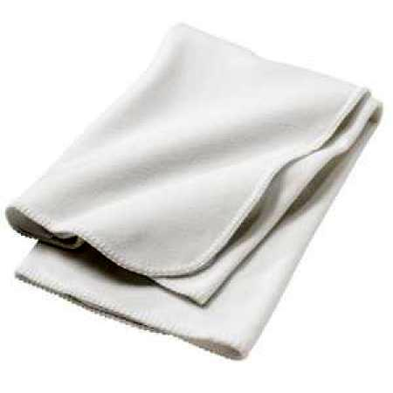
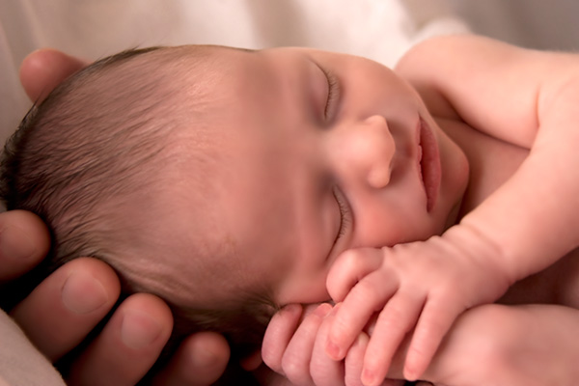
Thoughts Concerning Birth
I. Physical Birth.
  A. Man’s origins.
    Man’s creation (Gen. 2:7).
    Man’s companion (Gen. 2:18, 21-24).

Slide 2
Thoughts Concerning Birth
I. Physical Birth.
  B. Man’s sin (Gen. 2:1-12; 2:17; Rom. 5:18).
    Woman’s penalty (Gen. 3:16).
    Man’s penalty (Gen. 3:17-19).

Slide 3
Thoughts Concerning Birth
I. Physical Birth.
  C. Reminders in Life.
    Pain in childbirth.
      Sin’s significance.
      Resemblance to sorrows of life (John 16:16-22).
      Resemblance to the end of the age (1 Thess. 5:1-4).

Slide 4
Thoughts Concerning Birth
I. Physical Birth.
  C. Reminders in Life.
    Life of work.
      Work to provide (2 Thess. 3:10; 1 Tim. 5:8).
      Works of faith and obedience (Phil. 2:12-13; 1 Cor. 15:58; Rev. 14:13).

Slide 5
Thoughts Concerning Birth
II. Spiritual Birth.
  A. You must be “born again” (John 3:1-8; James. 2:26; Rom. 6:23; Eph. 2:1).
    Born of water (Rom. 6:3-6).
    Born of the Spirit (Eph. 4:20-24; Luke 17:20-21).

Slide 6
Thoughts Concerning Birth
II. Spiritual Birth.
  B. A new creation (2 Cor. 5:14-18; Jer. 31:34; 1 John 3:9).

