Slide 2
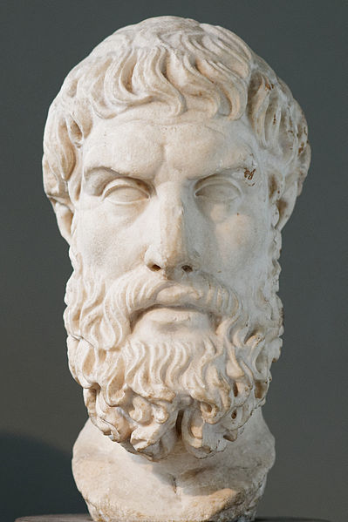
The Problem of Evil
The Epicurean Paradox
  Why Does God Allow Evil?
  Why doesn’t He remove it?
Willing but unable
Epicurus
Greek Philosopher
(341-270 BC)

Slide 3
The Problem of Evil
The Epicurean Paradox
  Why Does God Allow Evil?
  Why doesn’t He remove it?
Willing but unable
Feeble
Epicurus
Greek Philosopher
(341-270 BC)

Slide 4
The Problem of Evil
The Epicurean Paradox
  Why Does God Allow Evil?
  Why doesn’t He remove it?
Willing but unable
Feeble
God is not feeble
Epicurus
Greek Philosopher
(341-270 BC)

Slide 5
The Problem of Evil
The Epicurean Paradox
  Why Does God Allow Evil?
  Why doesn’t He remove it?
Willing but unable | Able but unwilling
Feeble
God is not feeble
Epicurus
Greek Philosopher
(341-270 BC)

Slide 6
The Problem of Evil
The Epicurean Paradox
  Why Does God Allow Evil?
  Why doesn’t He remove it?
Willing but unable | Able but unwilling
Feeble | Hateful
God is not feeble
Epicurus
Greek Philosopher
(341-270 BC)

Slide 7
The Problem of Evil
The Epicurean Paradox
  Why Does God Allow Evil?
  Why doesn’t He remove it?
Willing but unable | Able but unwilling
Feeble | Hateful
God is not feeble | God is not hateful
Epicurus
Greek Philosopher
(341-270 BC)

Slide 8
The Problem of Evil
The Epicurean Paradox
  Why Does God Allow Evil?
  Why doesn’t He remove it?
Willing but unable | Able but unwilling | Unwilling and unable
Feeble | Hateful
God is not feeble | God is not hateful
Epicurus
Greek Philosopher
(341-270 BC)

Slide 9
The Problem of Evil
The Epicurean Paradox
  Why Does God Allow Evil?
  Why doesn’t He remove it?
Willing but unable | Able but unwilling | Unwilling and unable
Feeble | Hateful | Feeble and Hateful
God is not feeble | God is not hateful
Epicurus
Greek Philosopher
(341-270 BC)

Slide 10
The Problem of Evil
The Epicurean Paradox
  Why Does God Allow Evil?
  Why doesn’t He remove it?
Willing but unable | Able but unwilling | Unwilling and unable
Feeble | Hateful | Feeble and Hateful
God is not feeble | God is not hateful | He is not God
Epicurus
Greek Philosopher
(341-270 BC)

Slide 11
The Problem of Evil
The Epicurean Paradox
  Why Does God Allow Evil?
  Why doesn’t He remove it?
Willing but unable | Able but unwilling | Unwilling and unable | Willing and able
Feeble | Hateful | Feeble and Hateful
God is not feeble | God is not hateful | He is not God
Epicurus
Greek Philosopher
(341-270 BC)

Slide 12
The Problem of Evil
The Epicurean Paradox
  Why Does God Allow Evil?
  Why doesn’t He remove it?
Willing but unable | Able but unwilling | Unwilling and unable | Willing and able
Feeble | Hateful | Feeble and Hateful | What is evil’s source?
God is not feeble | God is not hateful | He is not God
Epicurus
Greek Philosopher
(341-270 BC)

Slide 13
The Problem of Evil
The Epicurean Paradox
  Why Does God Allow Evil?
  Why doesn’t He remove it?
Willing but unable | Able but unwilling | Unwilling and unable | Willing and able
Feeble | Hateful | Feeble and Hateful | What is evil’s source?
God is not feeble | God is not hateful | He is not God | Why isn’t it removed?
Epicurus
Greek Philosopher
(341-270 BC)

Slide 14
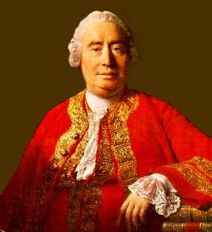
The Problem of Evil
The Epicurean Paradox
David Hume
  “Is he willing to prevent evil, but not able? Then he is impotent. Is he able, but not willing? Then he is malevolent. Is he both able and willing? Whence then is evil?”
  (Dialogues Concerning
  Natural Religion, 10).
David Hume
Skeptic Philosopher
(1711-1776)

Slide 15
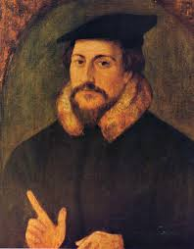
The Problem of Evil
The Epicurean Paradox
David Hume
John Calvin
  “Good as well as evil was produced by the command of God” (Institutes of the Christian Religion, 1.17.8).
  It is “the feebleness of our intellect” that keeps us from understanding how God “wills and wills not the very same thing” (ibid., 1.18.3).
John Calvin
Protestant Reformer
(1509-1564)

Slide 16
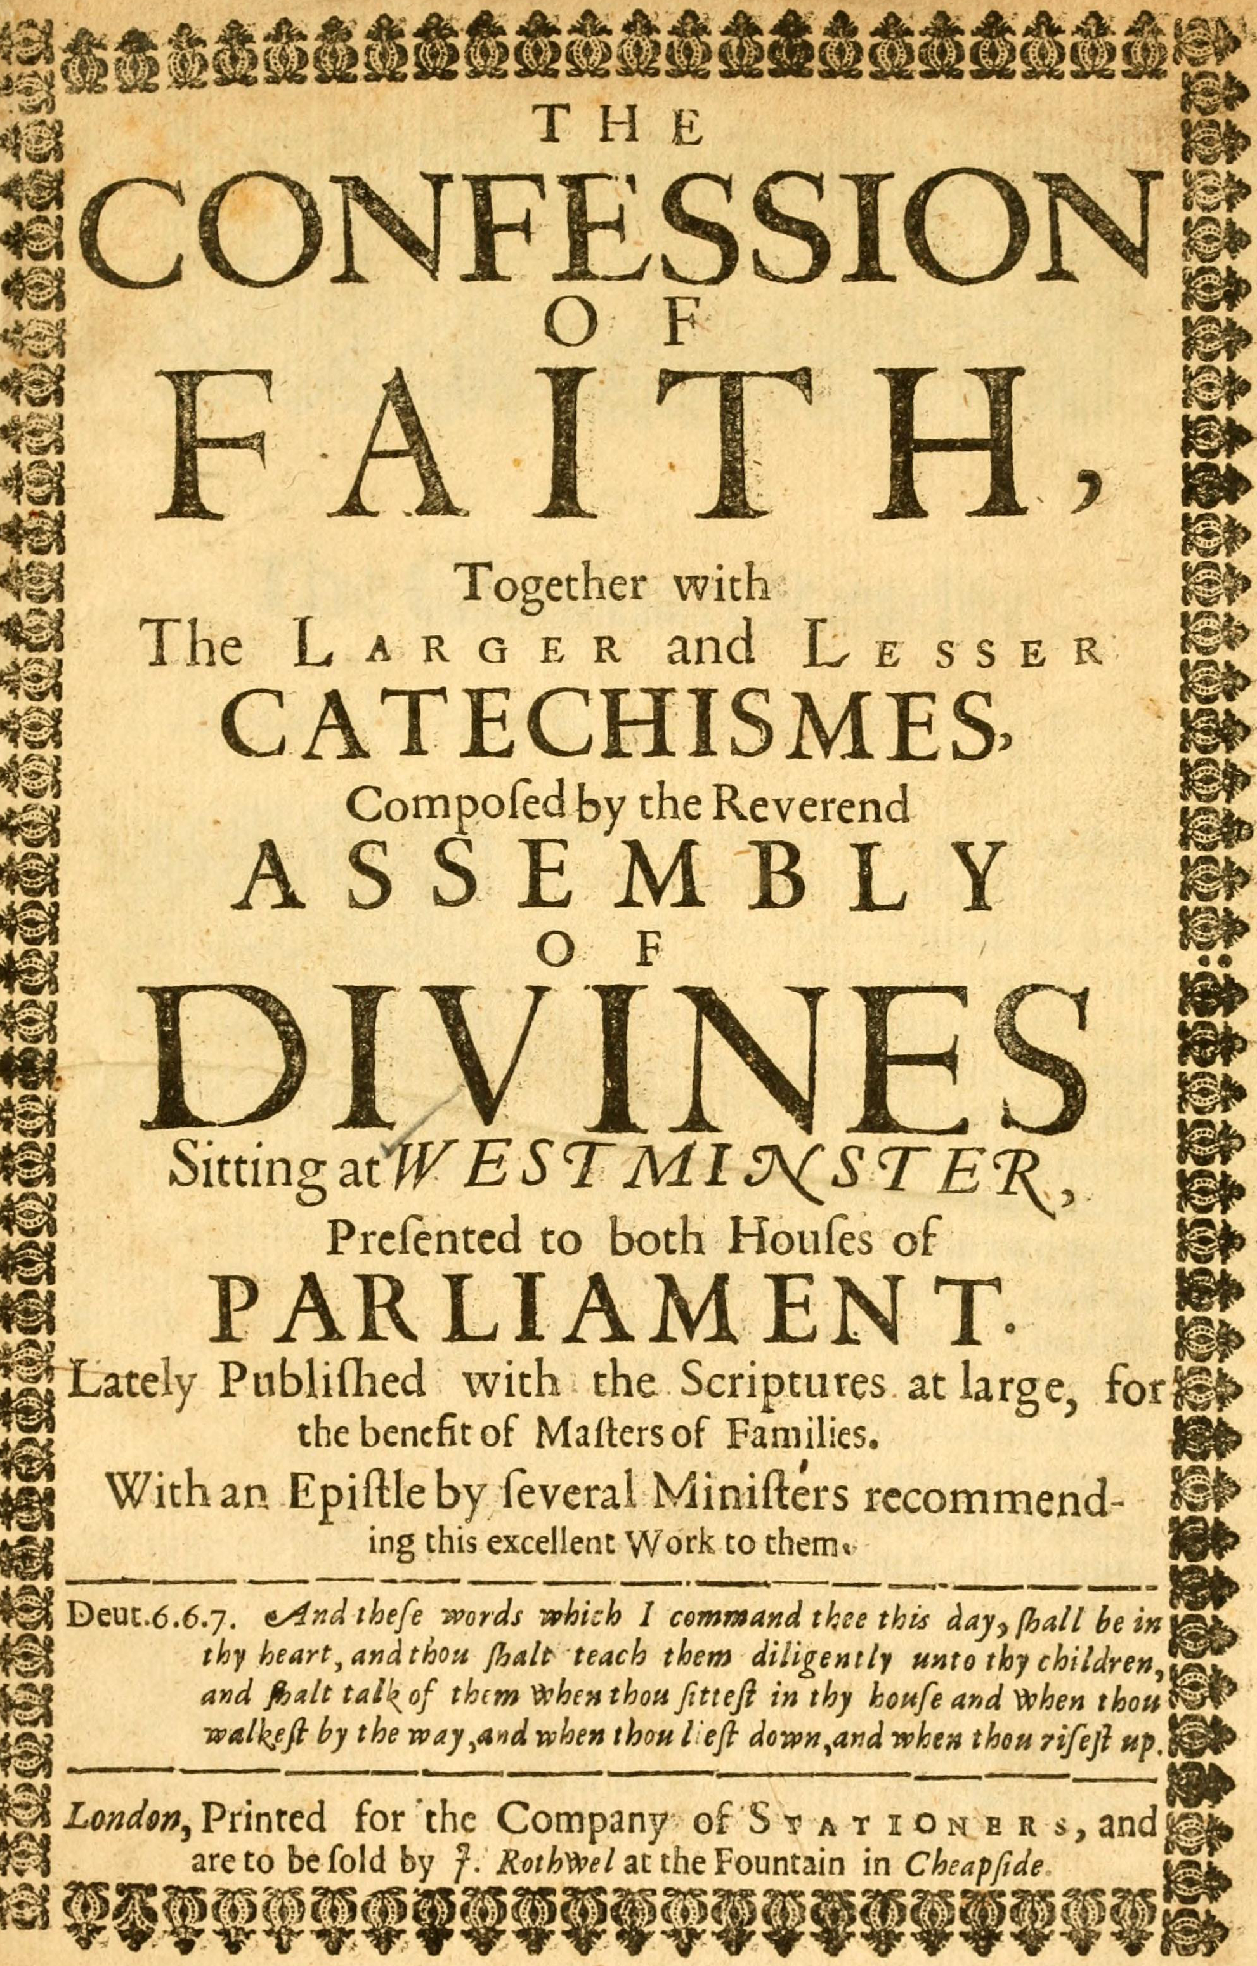
The Problem of Evil
The Epicurean Paradox
David Hume
John Calvin
Westminster Confession of Faith
  The power, wisdom, and goodness of God caused “the first fall, and all other sins of angels and men” and yet God somehow did it in such a way that human sinfulness comes, “only from the creature [i.e. human beings], and not from God” (Westminster Confession of Faith, “Of Providence,” 5.4).
Westminster Confession of Faith
1646

Slide 17

Is God to Blame for Human Wickedness?
What Is Evil?
  In English: “Profound immorality, wickedness, and depravity, esp. when regarded as a supernatural force” (New Oxford American Dictionary).
  In the OT, the Heb. verb ra‘a‘ meant “to be bad, to be evil” (BDB).
  In the NT, the Gr. adj. kakos could refer to things that are simply “troublesome” or to things that are “wicked” (Thayer).

Slide 18
Is God to Blame for Human Wickedness?
What Is Evil?
  Everything that is evil (as we use the term) could be said to be “bad,” but not everything “bad” is necessarily evil in any moral sense.
  A toothache is a bad thing, but it is not morally evil.

Slide 19
James 1:13-14
“Let no one say when he is tempted, ‘I am tempted by God’; for God cannot be tempted by evil (Gr. kakos), nor does He Himself tempt anyone. But each one is tempted when he is drawn away by his own desires and enticed” (NKJV).

Slide 20
Psalm 5:4
“You are not a God who takes pleasure in wickedness, nor shall evil (ra‘) dwell with You.”

Slide 21
Lamentations 3:38
“Out of the mouth of the most High proceedeth not evil (ra‘) and good?” (KJV).
“Woe and well-being” (NKJV).

Slide 22
Amos 3:6
“Shall a trumpet be blown in the city, and the people not be afraid? shall there be evil (ra‘) in a city, and the LORD hath not done it?” (KJV).
“Calamity” (NKJV).

Slide 23
Isaiah 45:7
“I form the light, and create darkness: I make peace, and create evil (ra‘): I the LORD do all these things.” (KJV).
“Calamity” (NKJV).

Slide 24
Is God to Blame for Human Wickedness?
What Is The Source of Evil?

Slide 25
James 1:14
“But each one is tempted when he is drawn away by his own desires and enticed” (NKJV).

Slide 26
Is God to Blame for Human Wickedness?
What Is The Source of Evil?
  All human desires have lawful outlets by which they can be fulfilled.
    The desire for food can lawfully be fulfilled by working for a living (2 Thess. 3:8).
    The desire for sexuality may be lawfully fulfilled in lawful marriage (1 Cor. 7:2-4).

Slide 27
Is God to Blame for Human Wickedness?
What Is The Source of Evil?
  Choosing to unlawfully satisfy desire is following “ungodly lusts” (Jude 18), or walking according to one’s “own lusts” (2 Pet. 3:3; Jude 16), and pursuing things that are the “desires of the flesh and of the mind” (Eph. 2:3).
  The source of all human wickedness can be traced to some unlawful attempt to satisfy desire in a way that is contrary to God’s revealed will.

Slide 28
Is God to Blame for Human Wickedness?
Why Doesn’t God Remove Evil?

Slide 29
Psalm 7:9
“Oh, let the wickedness of the wicked come to an end, But establish the just; For the righteous God tests the hearts and minds” (NKJV).

Slide 30
Acts 17:26-27
“…He has made from one blood every nation of men to dwell on all the face of the earth, and has determined their preappointed times and the boundaries of their dwellings, so that they should seek the Lord, in the hope that they might grope for Him and find Him, though He is not far from each one of us.”

Slide 31
Is God to Blame for Human Wickedness?
Why Doesn’t God Remove Evil?
  Is it evil on God’s part to allow the opportunity for the evil man does to harm others? No.
    He has commanded man not to do evil (2 Kings 17:13; Ezek. 18:32).
    He has limited the evil that man can do—our lifetimes are temporary (Gen. 6:3; Psa. 90:12).
    He will punish the wicked for their rebellion and any harm done to others (Jude 14-15).

