Slide 1

The Gospel
According to Barabbas

Slide 2
For Christ did not send me to baptize, but to preach the gospel, not with wisdom of words, lest the cross of Christ should be made of no effect. 1 Corinthians 1:17

Slide 3
The Gospel Is……
Literally:
The “Good Message” – Mark 1:1
Generally:
Justification – Galatians 3:8
Specifically:
An event - I Corinthians 15:1-4

Slide 4
The Gospel Is……
I Corinthians 15:1-4
Jesus DIED for our sins
He was BURIED
He ROSE FROM THE DEAD on the 3rd day
……….according to Scripture

Slide 5
The Record of the Event
Matthew
John
Mark
Luke

Slide 6
The Record of the Event
Matthew
An eye
witness
An Apostle
John
Mark
Luke

Slide 7
The Record of the Event
Matthew
An eye
witness
An Apostle
John
Mark
An eye
witness
Luke

Slide 8
The Record of the Event
Matthew
An eye
witness
An Apostle
John
Mark
An eye
witness
Luke
Not an eye
witness

Slide 9
The Record of the Event
Matthew
An eye
witness
An Apostle
John
An eye
witness
An Apostle
Mark
An eye
witness
Luke
Not an eye
witness

Slide 10
The Record of the Event
Common to all: The Freeing of Barabbas
Matthew 27:15-26
Mark 15:6-14
Luke 23:17-22
John 18:39-40

Slide 11
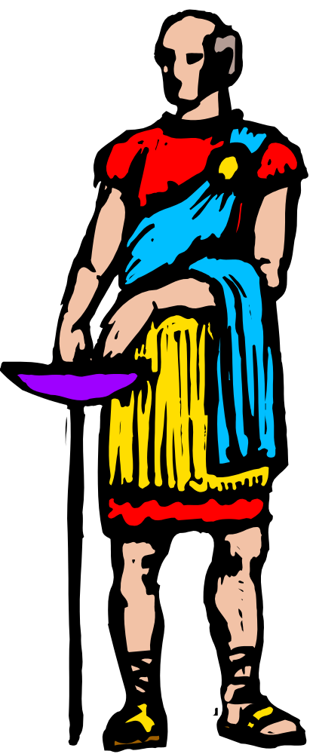
Who is this Barabbas?
Mark – a rebel and a murderer
Luke – a rebel and a murderer
John – a robber
“notorious”

Slide 12
Who is this Barabbas?
Pilate offers a choice:
A man with no guilt
OR
A man with complete guilt

Slide 13
Who is this Barabbas to us?
Barabbas is a man AND an allegory:
He represents those who are rightfully condemned to die (Luke 23:41)
Romans 3:23 for all have sinned and fall short of the glory of God
Romans 6:23 For the wages of sin is death

Slide 14
Who is this Barabbas to us?
Barabbas is a man AND an allegory:
He represents one whose penalty has been commuted in the death of another
1 Peter 2:24 who Himself bore our sins in His own body on the tree
1 Peter 3:18 For Christ also suffered once for sins, the just for the unjust

Slide 15
Who is this Barabbas to us?
Barabbas is a man AND an allegory:
He represents one whose “debt to society” has been paid and is free
John 19:30 So when Jesus had received the sour wine, He said, "It is finished!" And bowing His head, He gave up His spirit.
“it is finished” = Tetelesti
Similar to “paid in full”

Slide 16
Who is this Barabbas to us?
Barabbas

Slide 17
Who is this Barabbas to us?
Bar-Abbas

Slide 18
Who is this Barabbas to us?
Bar-Abbas
Son (of the) Father

Slide 19
Who is this Barabbas to us?
Bar-Abbas
Son (of the) Father
Romans 8:15 For you did not receive the spirit of bondage again to fear, but you received the Spirit of adoption by whom we cry out, "Abba, Father.“

Slide 20
Who is this Barabbas to us?
Bar-Abbas
Son (of the) Father
Galatians 4:6 And because you are sons, God has sent forth the Spirit of His Son into your hearts, crying out, "Abba, Father!"

Slide 21
Who is this Barabbas to us?
Bar-Abbas
Son (of the) Father
2 Corinthians 6:18 "I will be a Father to you, and you shall be My sons and daughters” says the LORD Almighty.

Slide 22
Who is this Barabbas to us?
Bar-Abbas
Son of the Father
Barabbas’ Gospel is the story of anyone who has been saved by the Gospel

Slide 23

The Gospel According Barabbas
The vileness of our sins to God
The innocence of Christ to deliver us
The question becomes: will we receive it?

Slide 24
Obeying the Gospel
(Jesus will one day come) in flaming fire taking vengeance on those who do not know God, and on those who do not obey the gospel of our Lord Jesus Christ. 2 Thessalonians 1:8
For the time has come for judgment to begin at the house of God; and if it begins with us first, what will be the end of those who do not obey the gospel of God? 1 Peter 4:17

Slide 25
Obeying the Gospel
How does one “obey” the Gospel?
How does one “obey” Christ’s death, burial, and resurrection?

Slide 26
Obeying the Gospel
Or do you not know that as many of us as were baptized into Christ Jesus were baptized into His death? Therefore we were buried with Him through baptism into death, that just as Christ was raised from the dead by the glory of the Father, even so we also should walk in newness of life. For if we have been united together in the likeness of His death, certainly we also shall be in the likeness of His resurrection, Romans 6:3-5

