Slide 1
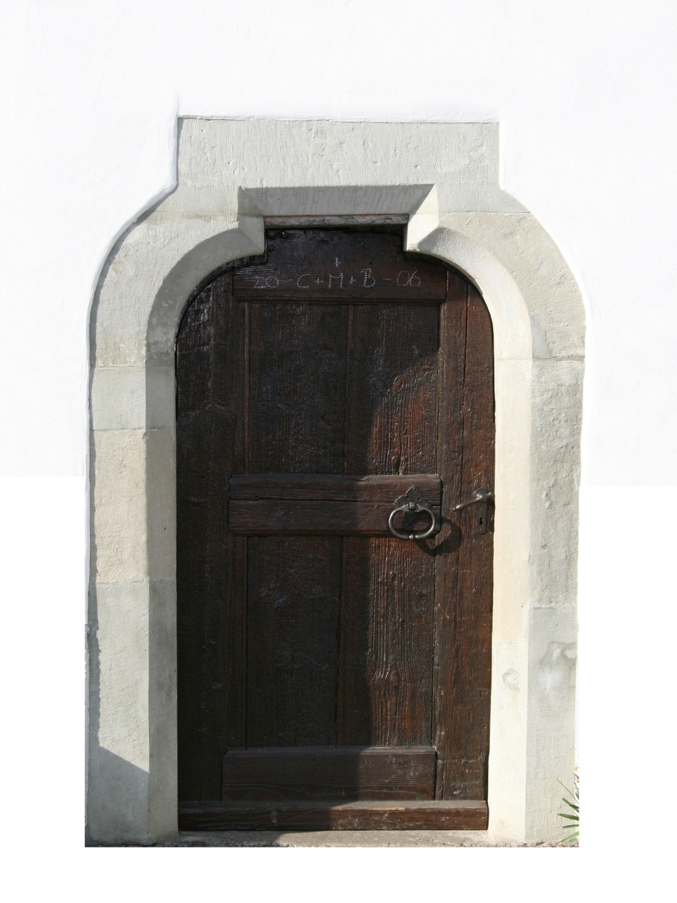
The Passover Terror
Exodus 12:3-13

Slide 2
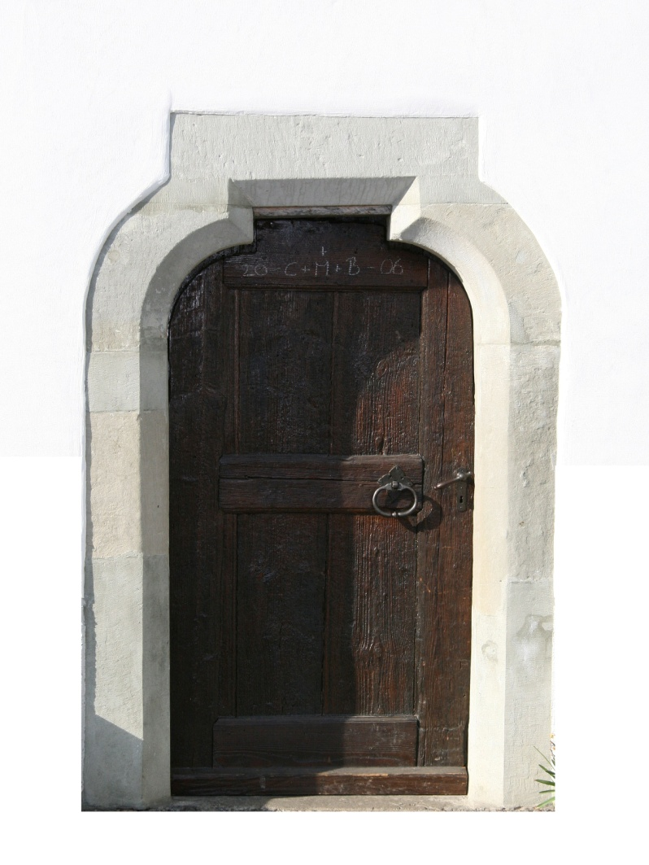
The Passover Terror
Now all these things happened to them as examples, and they were written for our admonition, upon whom the ends of the ages have come. 1 Corinthians 10:11

Slide 3
The Passover Pattern
Death waiting outside
Safety by passing through a door
Safety only by remaining

Slide 4
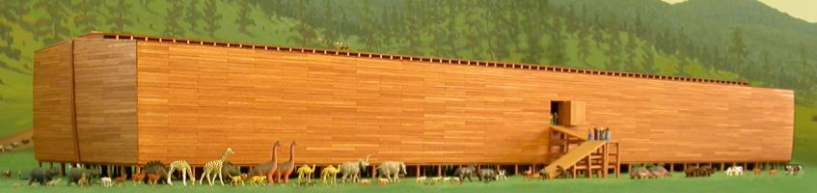
The Passover Pattern
Genesis 6:13-17
Death waiting outside
Safety by passing through a door
Safety only by remaining

Slide 5
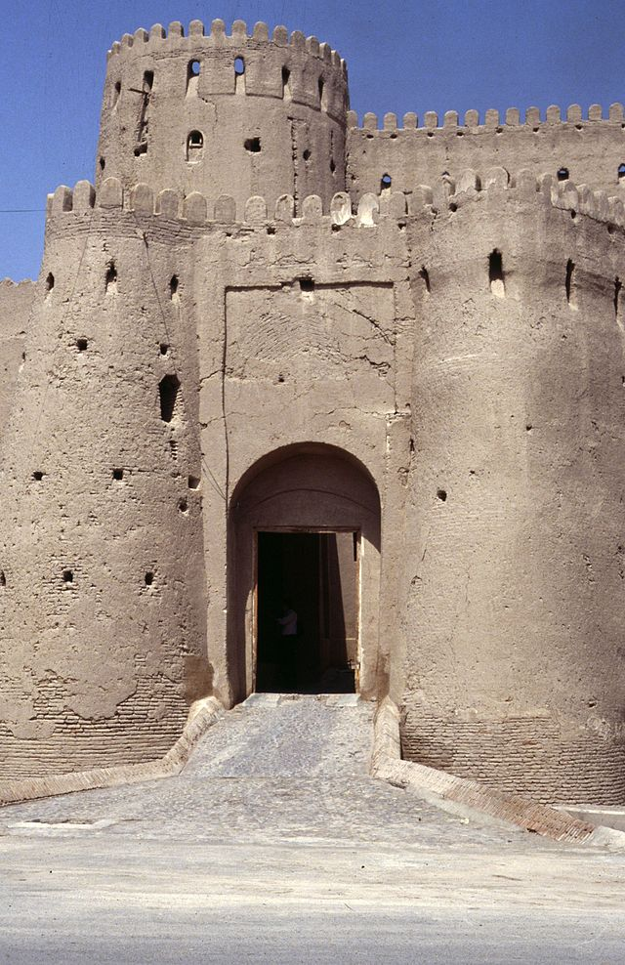
The Passover Pattern
Numbers 35:14-24
Death waiting outside
Safety by passing through a door
Safety only by remaining

Slide 6
Now all these things happened to them as examples, and they were written for our admonition, upon whom the ends of the ages have come. 1 Corinthians 10:11

Slide 7
The Passover Pattern Revealed
Hebrews 10:23-25 - The Church of Christ:
Purchased with blood - Acts 20:28
Covered with atonement – Ephesians 5:26
A city of refuge – Hebrews 11:16

Slide 8
The Passover Pattern Revealed
Hebrews 10:23-25 - The Church of Christ:
Death waiting outside
Safety by passing through a door
Safety only by remaining

Slide 9
The Passover Pattern Revealed
The Church: Death waiting outside
Hebrews 6:18, John 14:6
The Church: entering through a door
John 10:9, Galatians 3:27
The Church: Safety in remaining
Hebrews 10:26-29

Slide 10
Entrance Requirements
To have faith – John 3:16
To confess Him – Luke 12:8
To repent – Matthew 4:18
To be baptized – Mark 16:16
To remain faithful – Revelation 2:10
The time is now!

