Slide 1
Learning To
Put Off Bitterness
Colossians 3:19

Slide 2
Do I Struggle With Bitterness?
Husbands bitter against their wives
Wives bitter against their husbands
Children bitter against their parents
Parents bitter against their children
Saints bitter against one another

Slide 3
Danger of Bitterness
See to it that no one comes short of the grace of God; that no root of bitterness springing up causes trouble, and by it many be defiled; Hebrews 12:15

Slide 4

Danger of Bitterness
Root of bitterness
How is it a “root”?
A “tree” of bad behavior?
A “thorn” of rejection?
By it many be defiled…….
Genesis 4:3-8

Slide 5
Defiling Behaviors
Husbands bitter against their wives
Wives bitter against their husbands
Children bitter against their parents
Parents bitter against their children
Saints bitter against one another

Slide 6
Bitterness
Let all bitterness and wrath and anger and clamor and slander be put away from you, along with all malice. Ephesians 4:31

Slide 7

Bitterness
How do we “put away” bitterness?
Airo – pick it up
Matthew 9:1-6
"Get up, pick up your bed and go home.”

Slide 8
Bitterness
How does God put away bitterness?
He demands no repayment
He simply “lets go”
God expects reciprocal conduct….
Matthew 18:21-35

Slide 9
Bitterness
Learning to put away bitterness:
1. It has no value to you
2. You are better without it
3. God put away bitterness for you
Notes:
Scriptural purpose of Baptism

Slide 10
Conclusions
Bitterness happens in close relationships
It leads to ungodly harmful conduct
We must “put it away”
God is our living example

Slide 11
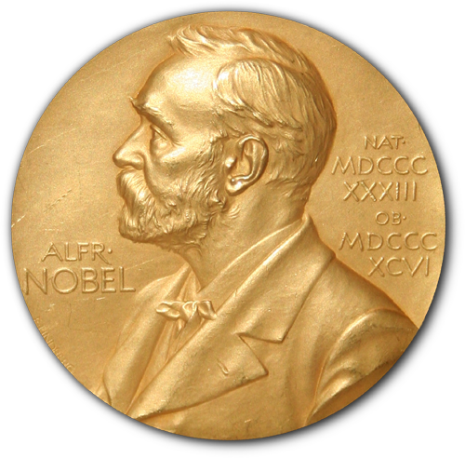
Renewing Ourselves
Hear and Believe - Acts 4:4
Confess Jesus as Lord – Acts 8:37
Repent of your sins – Acts 2:38
Be baptized in water – Acts 22:16

