Slide 1
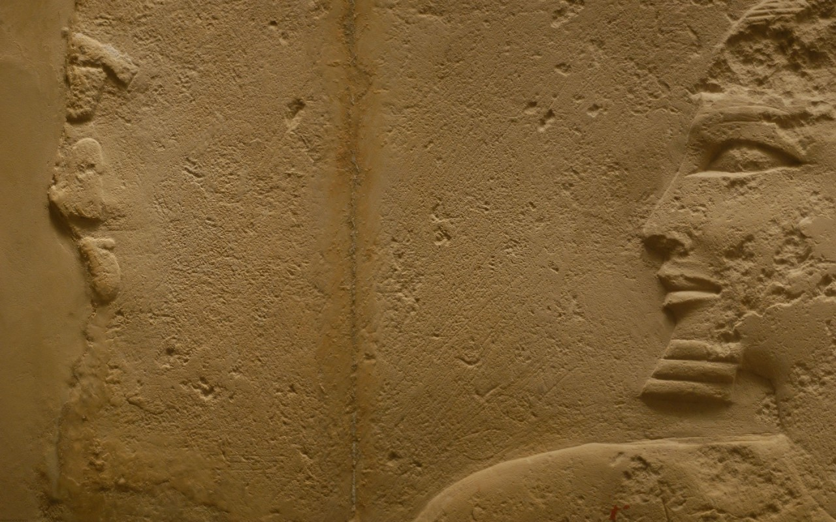

David Wolpe
“…Virtually every modern archaeologist who has investigated the story of the Exodus, with very few exceptions, agrees that the way the Bible describes the Exodus is not the way it happened, if it happened at all.”
Tugend, Tom. “L.A. Rabbi Creates Furor by
Questioning Exodus Story” Jweekly.com May 4, 2001
“It doesn’t matter”

Slide 2
Did the Exodus Really Happen?
It Matters a Great Deal
Promised to Abraham (Gen. 15:13-14; Acts 7:6).
Focal point of Israelite history .
Prophetically foreshadowed Jesus’ time in Egypt (Hos. 11:1; Matt. 2:15).
Jesus affirmed the reality of Exodus events:
Giving of the Law (John 7:19)
Manna (John 6:31-32)
Messianic prophecies (John 5:45)Disciples—historical fact (Acts 7:36; 13:17; Heb. 3:16; Jude 5)
Compared baptism and Red Sea crossing—Jesus as the “rock” (1 Cor. 10:1-4).

Slide 3




Tim Mahoney
Patterns of Evidence: Exodus (Thinking Man Films, 2014)

Slide 4
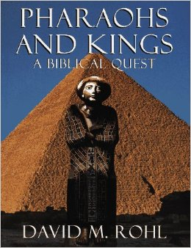

David Rohl
“New Chronology”
Pharaohs and Kings: A Biblical Quest (New York: Crown Publishers, 1995)

Slide 5
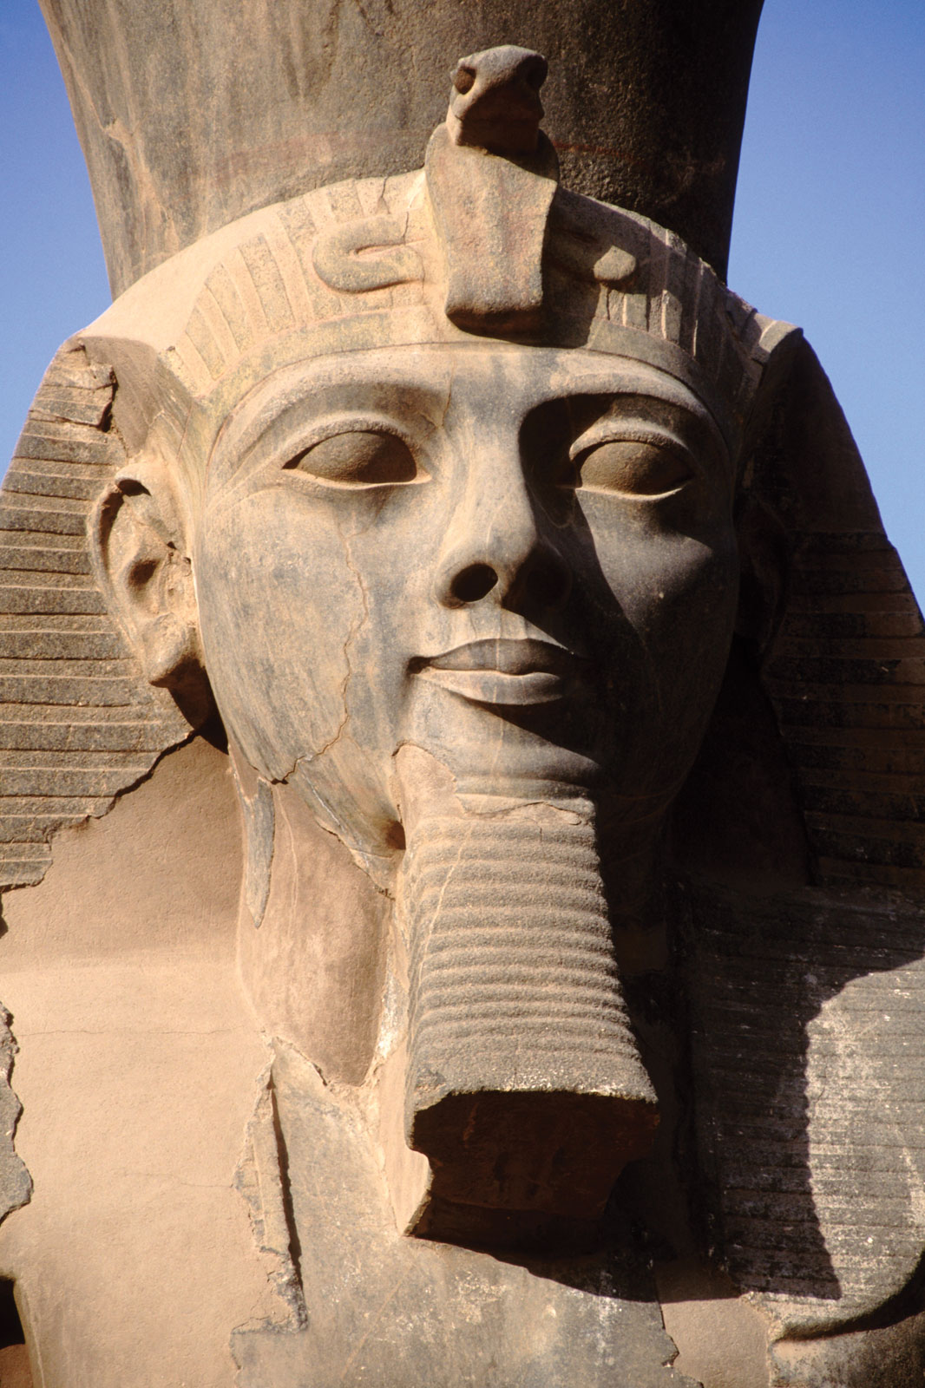
Did the Exodus Really Happen?
“Pithom and Raamses” (Exod. 1:11), or “Rameses” (Exod. 12:37).
Rameses II
(1279–1213 BC.)

Slide 6
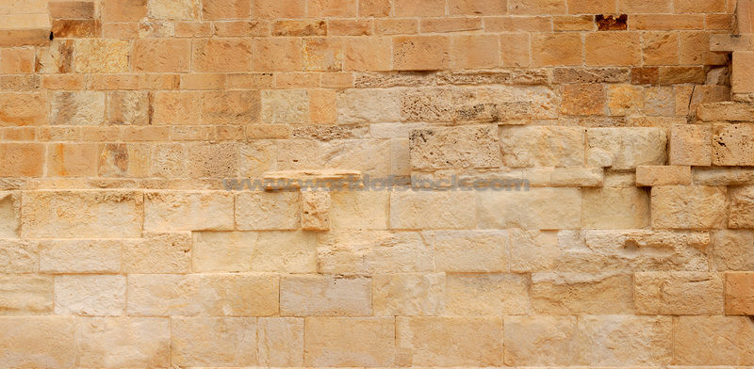
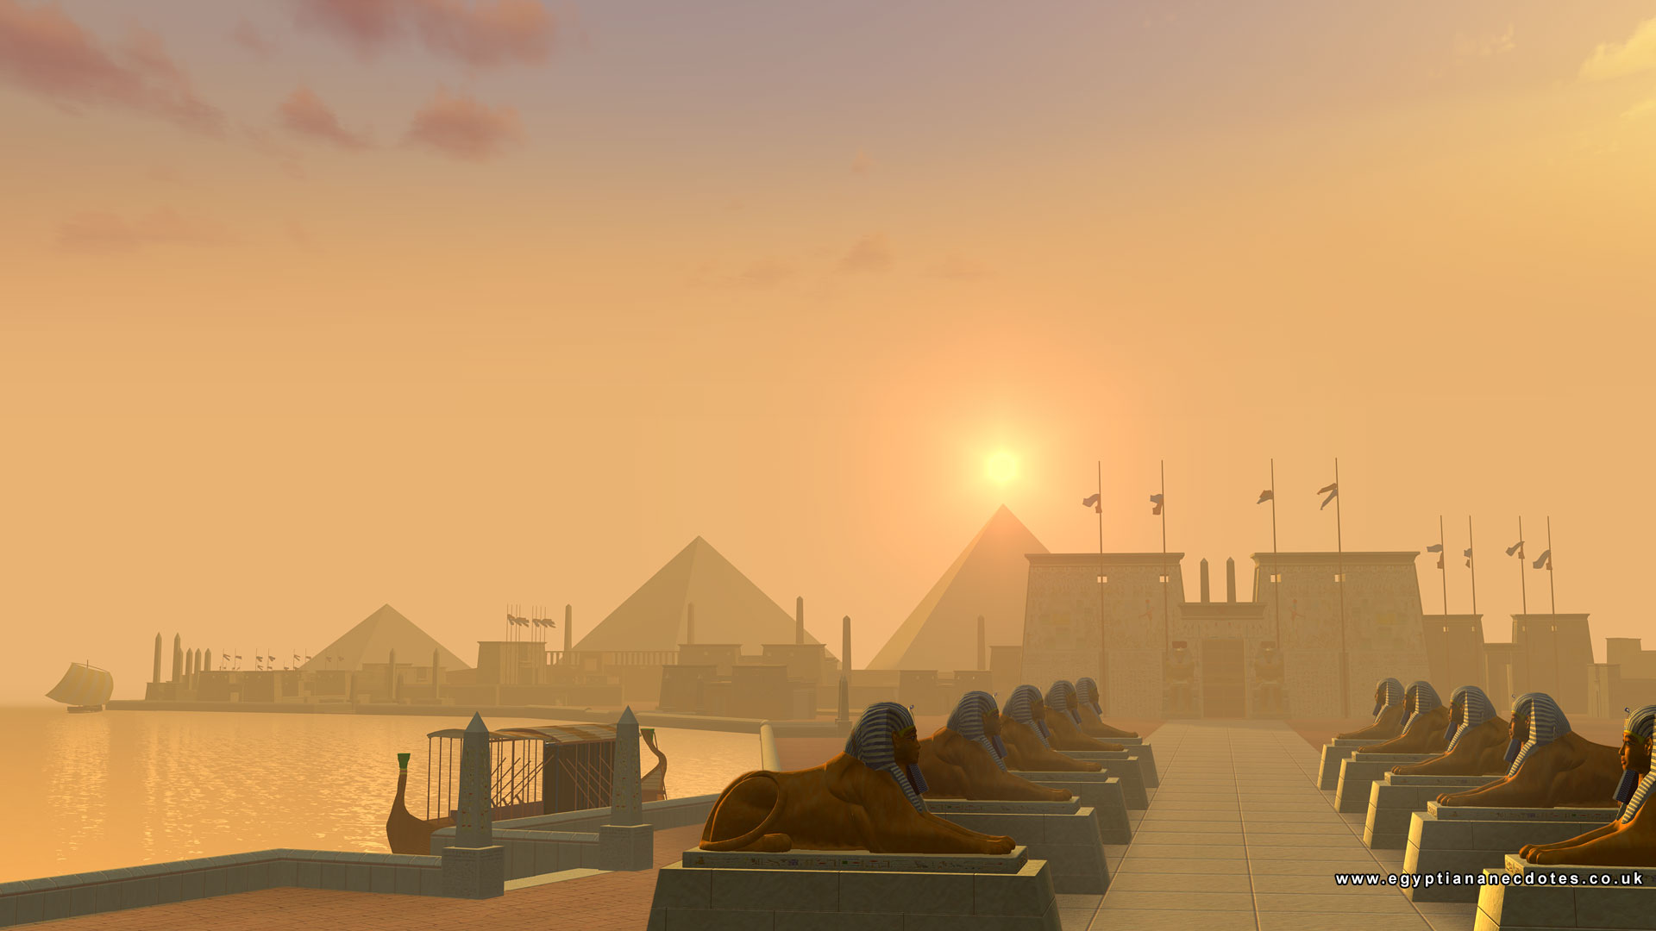

Timeline of History
Exodus
1700
1600
1500
1400
1300
1200
1100
1000
900
800
Rameses II

Slide 7
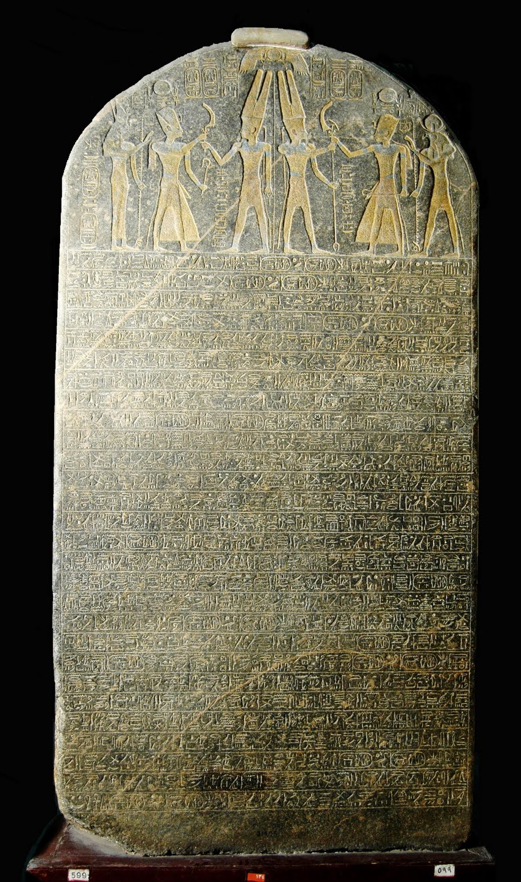
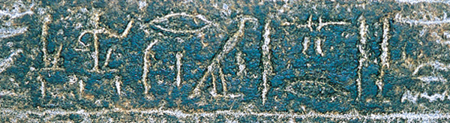
Stele of Merneptah II
“Seed of Israel”
Merneptah II
(1213-1204 BC)

Slide 8
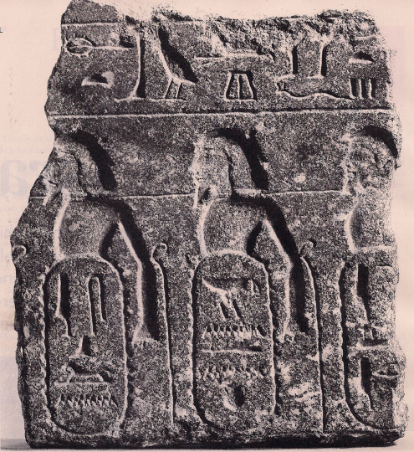
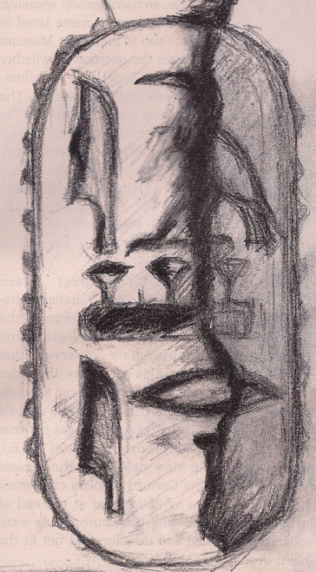
Berlin Pedestal
“Israel”
1350 BC

Slide 9
Timeline of History
Berlin Pedestal
1700
1600
1500
1400
1300
1200
1100
1000
900
800
Rameses II

Slide 10
Did the Exodus Really Happen?
“…In the four hundred and eightieth year after the children of Israel had come out of the land of Egypt, in the fourth year of Solomon’s reign” (1 Kings 6:1).

Slide 11
Timeline of History
480 years
1456 BC
Exodus
Solomon
970 BC
1700
1600
1500
1400
1300
1200
1100
1000
900
800
Rameses II

Slide 12
Did the Exodus Really Happen?
Shishak brought 12,000 chariots, 60,000 horsemen and “people without number” against fortified cities in Judah (2 Chron. 12:2-4) and “took away everything” from the temple and gold shields Solomon had made (1 Kings 14:26).

Slide 13
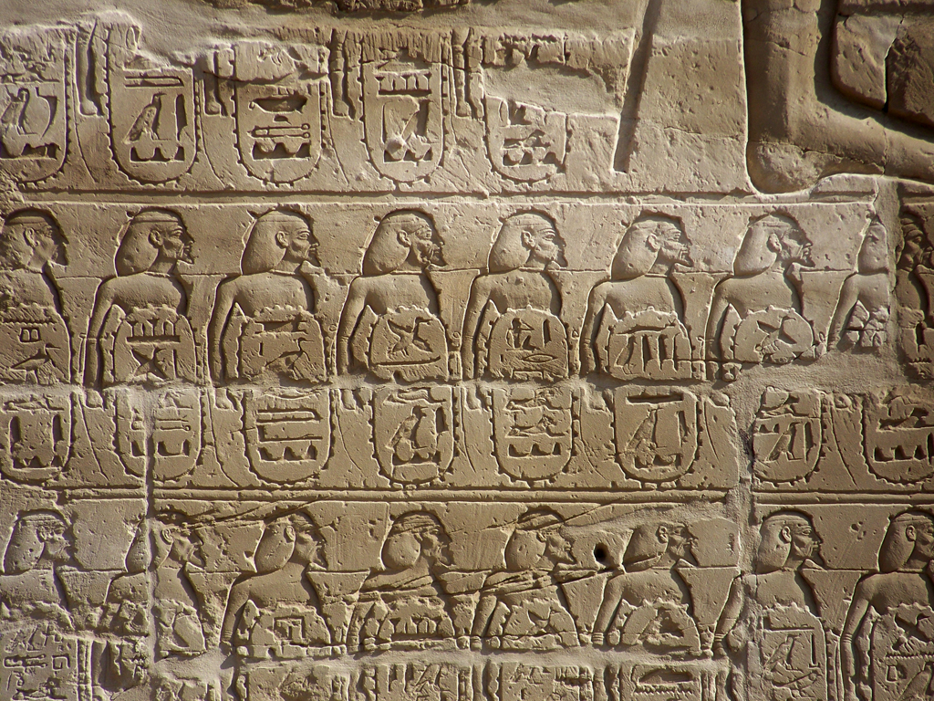
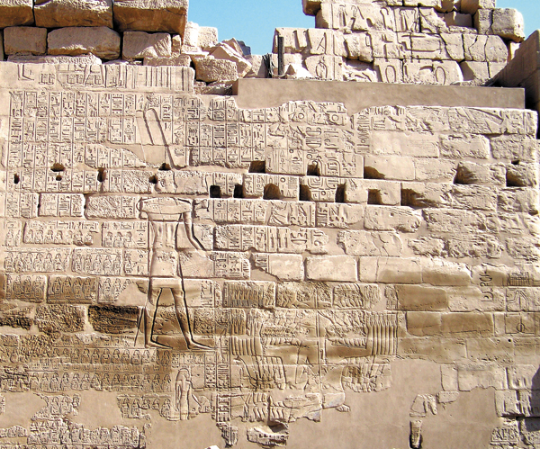
Triumphal Relief of Shoshenq I
Doesn’t list Jerusalem
More Israelite Cities than Judean

Slide 14
Did the Exodus Really Happen?
Shishak brought 12,000 chariots, 60,000 horsemen and “people without number” against fortified cities in Judah (2 Chron. 12:2-4) and “took away everything” from the temple and gold shields Solomon had made (1 Kings 14:26).
The Biblical Shishak gave Jeroboam refuge (1 Kings 11:40).

Slide 15
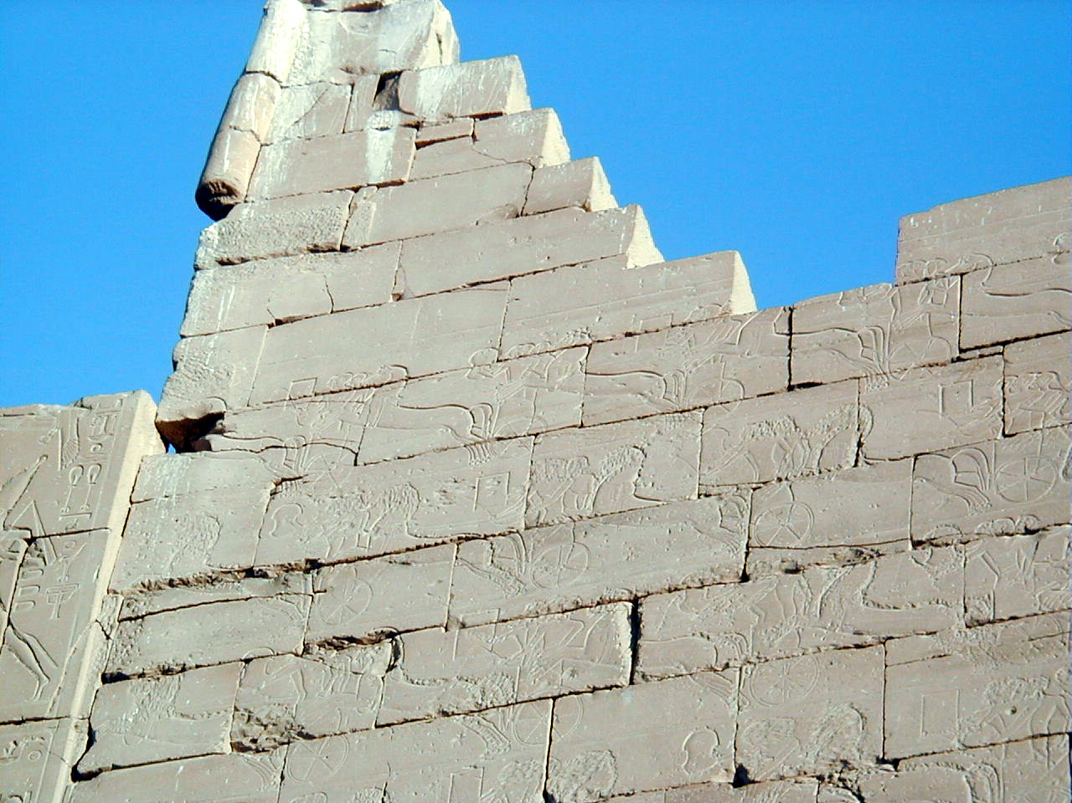
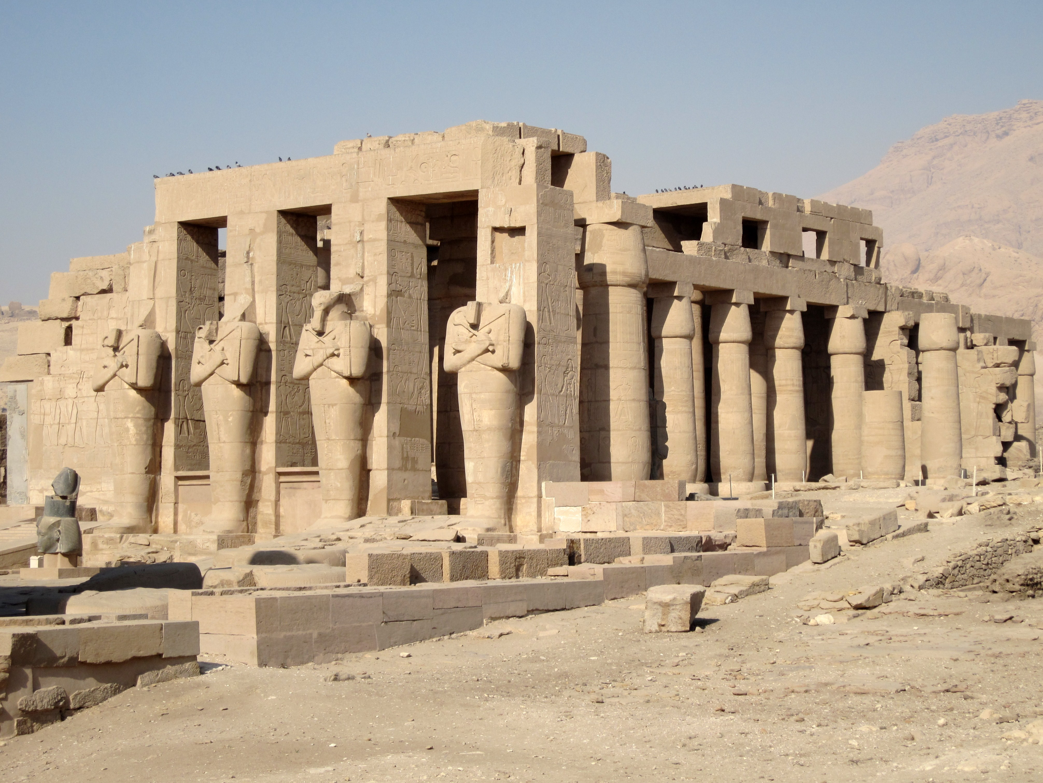
Ramesseum of
Rameses II
“Shalem”
= Jerusalem
(cf. Gen. 14:18; Heb. 7:1-2)

Slide 16
Timeline of History
Exodus
1456 BC
480 years
Solomon
970 BC
1700
1600
1500
1400
1300
1200
1100
1000
900
800
943-877
Rameses II

Slide 17
Did the Exodus Really Happen?
The Problem is Not a Lack of Evidence
It is a Problem of Dating
Much Evidence Matching the Biblical Record had been Considered too Early
If the “New Chronology” is Accurate That is No Longer the Case

Slide 18
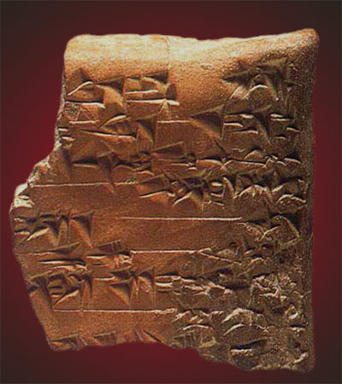
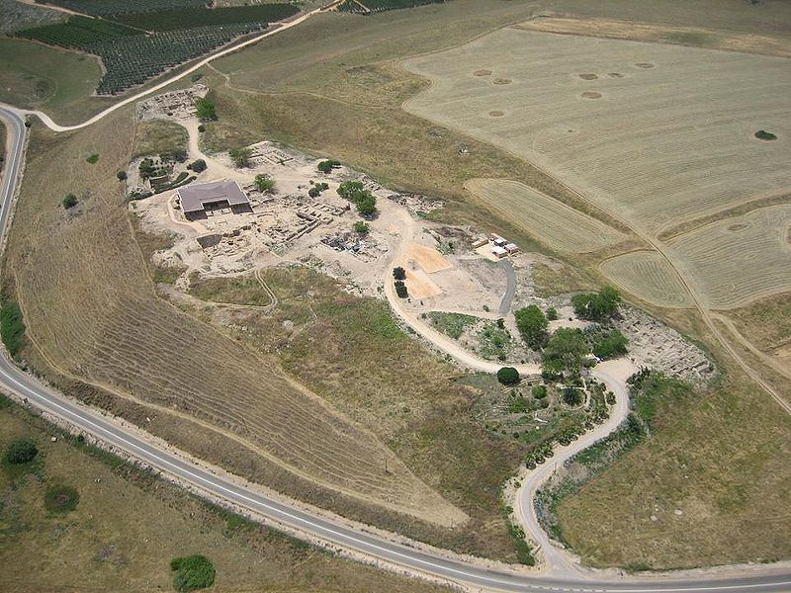
Evidence of a
Conquest of Palestine
Hazor
“Jabin”
Destruction and burning of the city

Slide 19
Did the Exodus Really Happen?
Evidence of a Conquest of Palestine
    Hazor—matches the biblical account (Josh. 11:1-11).

Slide 20
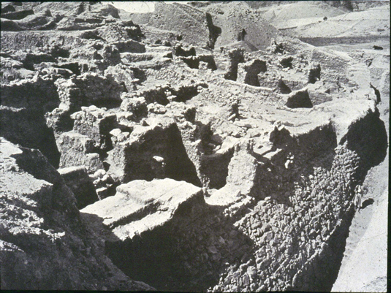
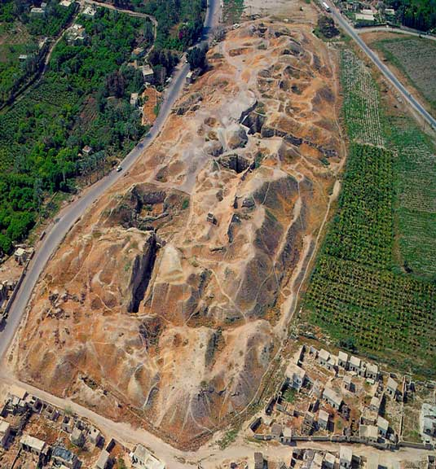
Evidence of a
Conquest of Palestine
Jericho
A section of the walls left intact
Fallen walls burned after falling

Slide 21
Did the Exodus Really Happen?
Evidence of a Conquest of Palestine
    Hazor—matches the biblical account (Josh. 11:1-11).
    Jericho—matches the biblical account (Josh. 6:1-25).

Slide 22

Evidence of a
Departure from Egypt
Manetho
Egyptian Historian
Hykssos
Took over Egypt without battle
Josephus, Against Apion 1.73

Slide 23
Did the Exodus Really Happen?
Evidence of a Departure from Egypt
    Egypt was still “destroyed” forty years after the Exodus (Deut. 11:3).

Slide 24
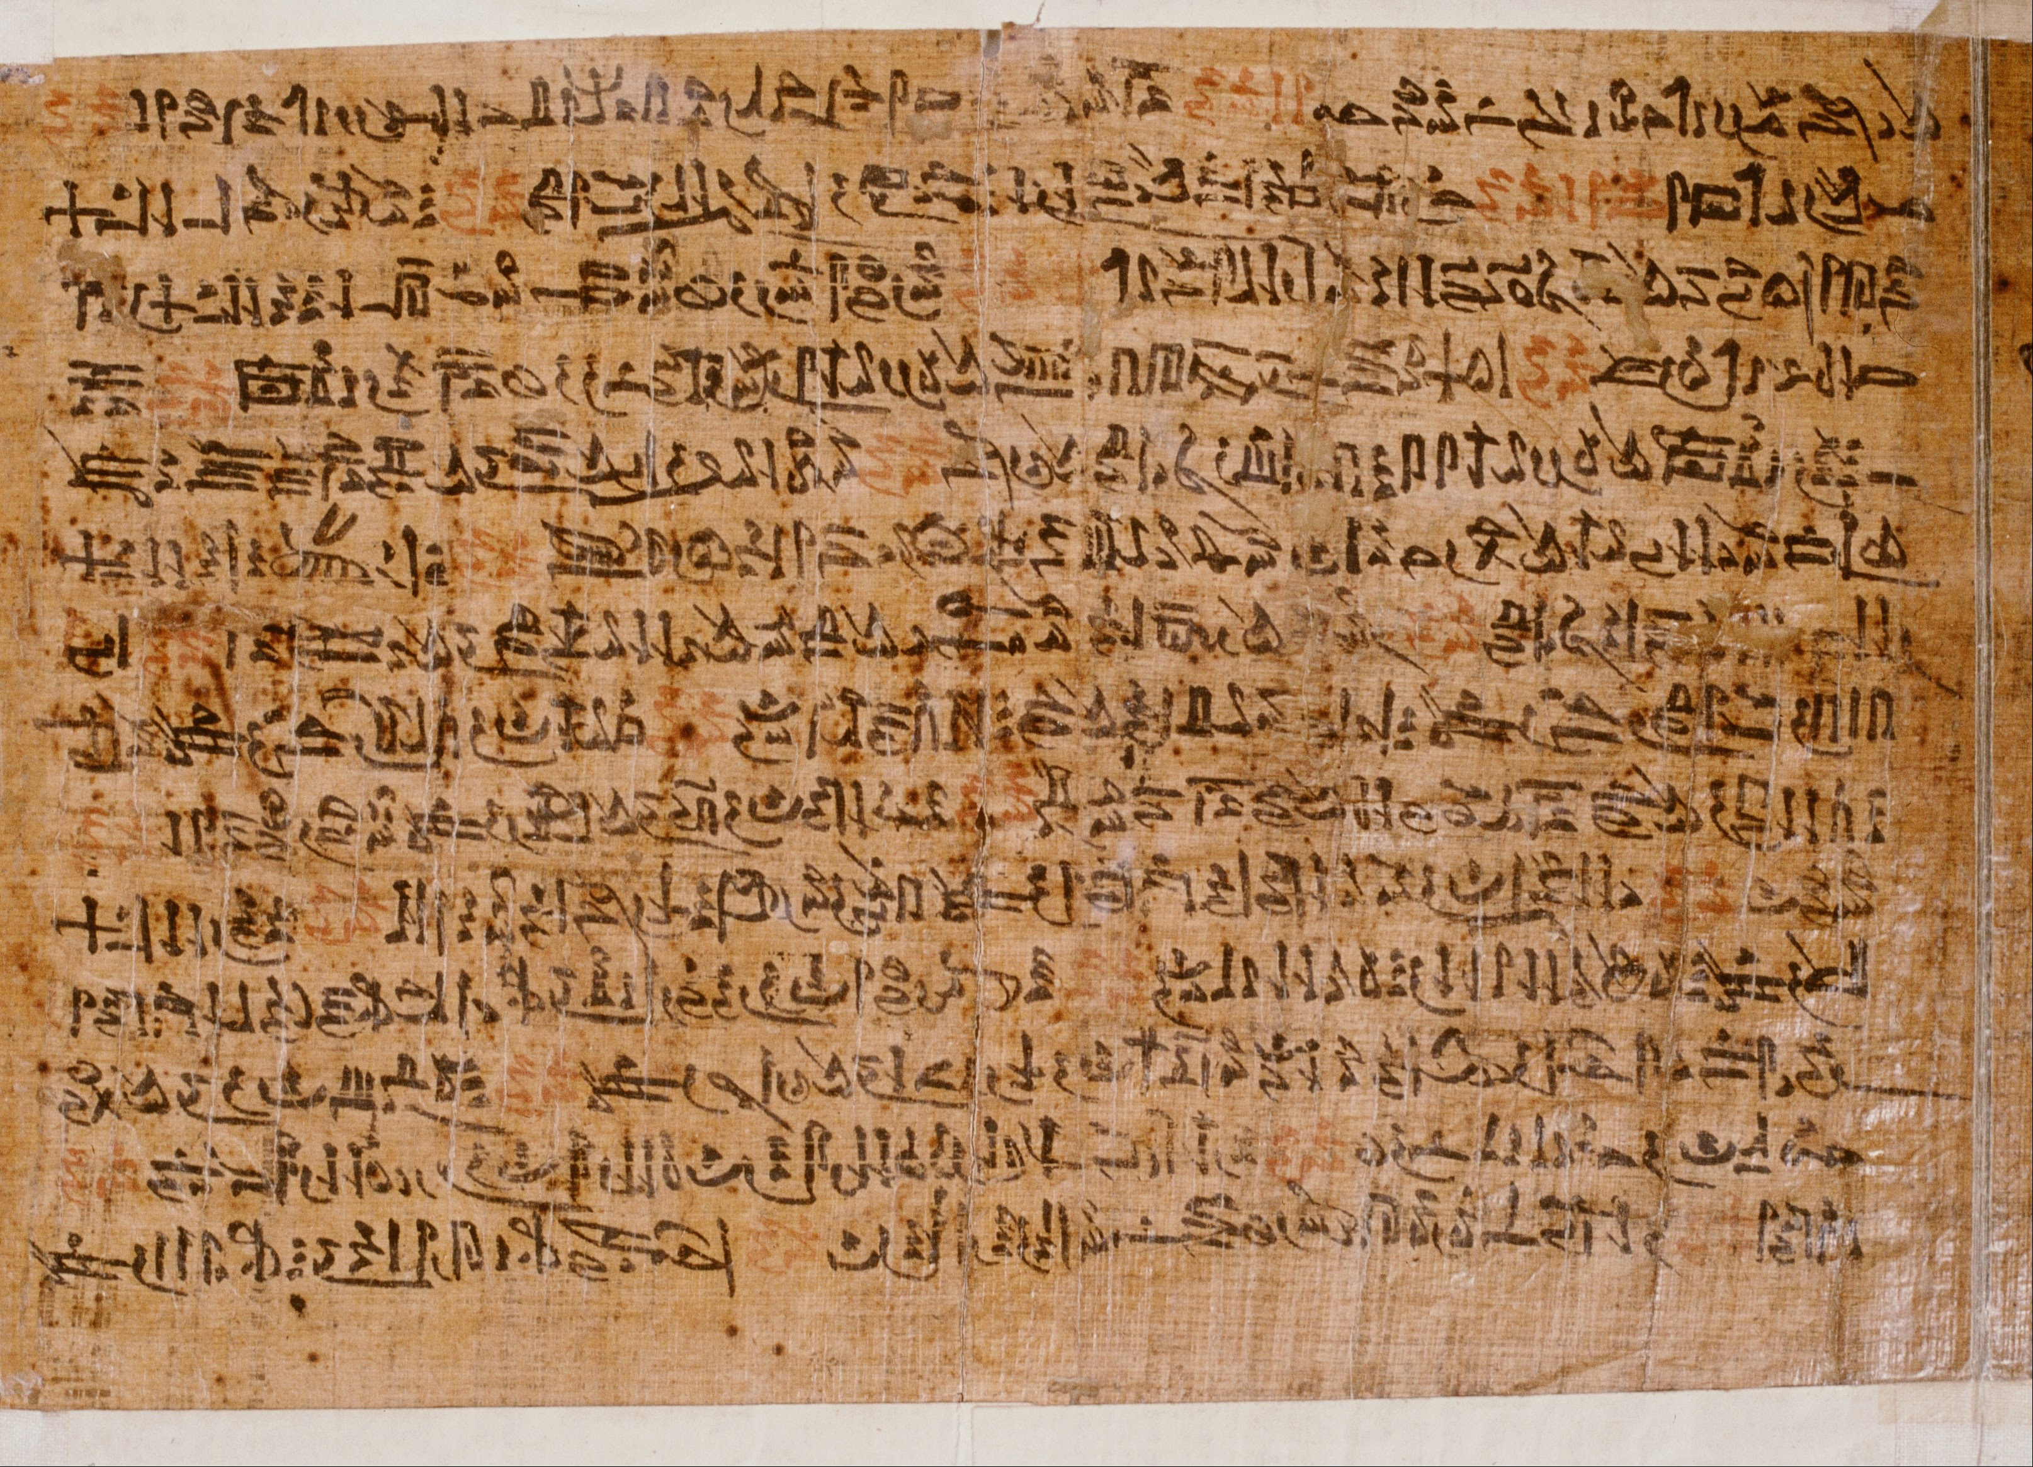
Evidence of a
Departure from Egypt
Leiden Papyrus
Nile turned to blood, death everywhere, and the servants taking possessions of the treasures of the rich.

Slide 25
Did the Exodus Really Happen?
Evidence of a Departure from Egypt
    Egypt was still “destroyed” forty years after the Exodus (Deut. 11:3).
    Plagues and plunder (Exod. 7-12).

Slide 26
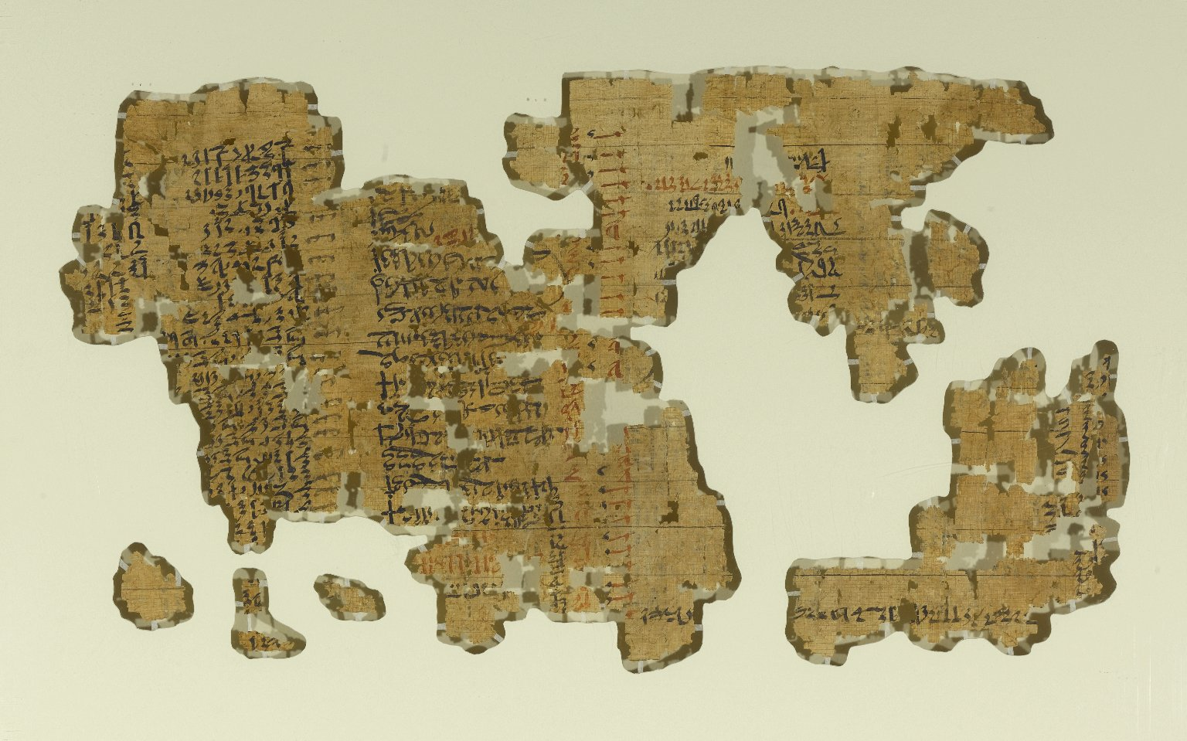
Evidence of a
Departure from Egypt
Brooklyn Papyrus
Hebrew names of slaves: Ashera=Asher (Gen. 30:13) and Sekera=Issachar (Gen. 30:18), ‘Aqoba=Jacob, and Shiphrah, Hebrew midwife (Exod. 1:15).

Slide 27
Did the Exodus Really Happen?
Evidence of a Departure from Egypt
    Egypt was still “destroyed” forty years after the Exodus (Deut. 11:3).
    Plagues and plunder (Exod. 7-12).
    Israelites were enslaved (Exod. 1:9-14).

Slide 28
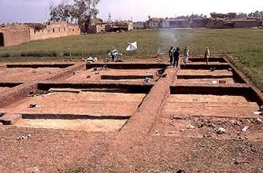
Evidence of a
Departure from Egypt
Rameses was also called Avaris
Home of Semitic Peoples—not Egyptians
Sudden departure from this city

Slide 29
Did the Exodus Really Happen?
Evidence of a Departure from Egypt
    Egypt was still “destroyed” forty years after the Exodus (Deut. 11:3).
    Plagues and plunder (Exod. 7-12).
    Israelites were enslaved (Exod. 1:9-14).
    The city from which Israelites departed when they left Egypt (Exod. 12:37).

Slide 30
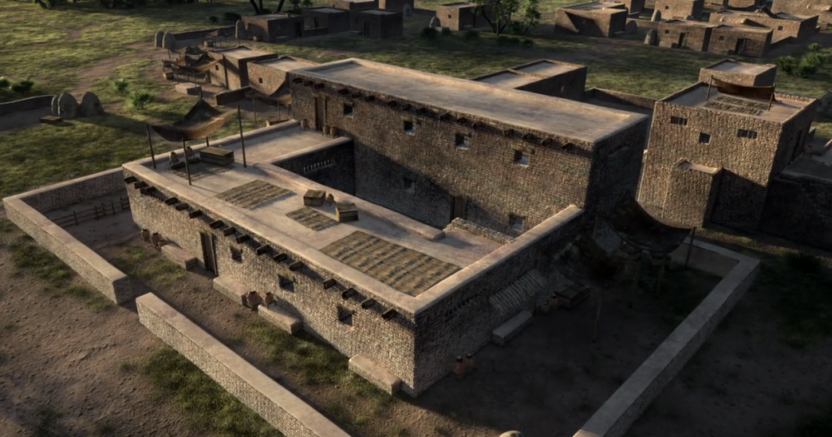
Evidence of a
Sojourn in Egypt
Avaris
Ruins of Israelite
“four-room” type house

Slide 31
Did the Exodus Really Happen?
Evidence of a Sojourn in Egypt
    Pharaoh gave Joseph’s family a place to live in Goshen—where Avaris is located (Gen. 47:6, 27).

Slide 32
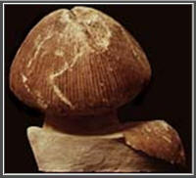
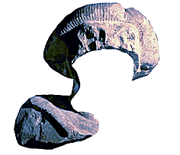
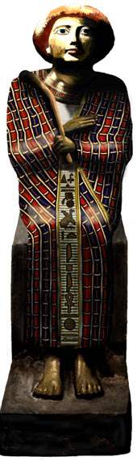
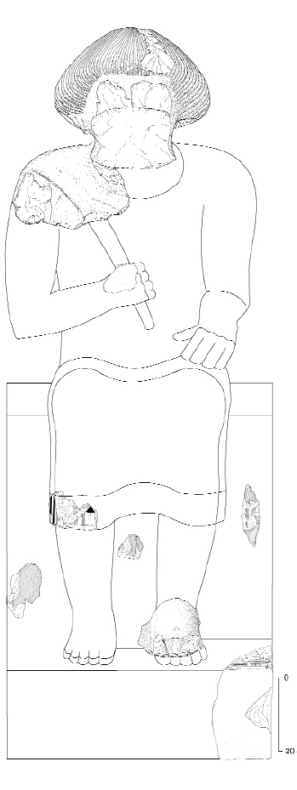
Evidence of a
Sojourn in Egypt
Avaris
Ruins of a large tomb with a statue of a Semitic man of some importance.

Slide 33
Did the Exodus Really Happen?
Evidence of a Sojourn in Egypt
    Pharaoh gave Joseph’s family a place to live in Goshen—where Avaris is located (Gen. 47:6, 27).
    Pharaoh made Joseph (a non-Egyptian) second to him over all Egypt (Gen. 41:41-45).

Slide 34
Evidence of a
Sojourn in Egypt
Avaris
Ruins of a large tomb with a statue of a Semitic man of some importance.
Was this Joseph?

