Slide 1


Evolution
“Change”
• Micro-evolution. Changes that happen within different kinds of life (i.e. Chihuahua and Great Dane, are very different, but are both dogs). This is not theory—it is fact.
• Macro-evolution. The theory that a species can change to another species over time (i.e. Amoeba to Man). This is still a theory, and has not been proven or observed.

Slide 2

Theistic Evolution
Argues that God created all life through an evolutionary process.
Unraveling Evolution (Athens: AL, Truth Publications, Inc. 2017)
Josh Gurtler

Slide 3
Reasons Christians Should Not Accept Theistic Evolution
1. The Scriptures teach that the Genesis record of creation is a literal and historic account (Exod. 20:11; Mark 10:6; Rom. 1:20, 21).
  • Theistic evolution argues that Genesis chapters one and two are totally symbolic, or that parts are literal while other parts are allegorical.
  • This often extends on into chapter three, allegorizing particulars such as Satan’s temptation of Eve while in the form of a serpent.

Slide 4
Reasons Christians Should Not Accept Theistic Evolution
2. The Scripture says that God ceased from all his creative work “from the foundation of the world” (Gen. 2:2; Heb. 4:3, 10).
  • Theistic evolution says that God’s creative work can be seen in the evolution of all life forms and even continues to this day.

Slide 5
Reasons Christians Should Not Accept Theistic Evolution
3. The Scriptures teach that creation occurred instantaneously at the command of God (Gen. 1:3, 6, 9, 14, 20, 24; Ps. 33:6-9; Heb. 11:3).
  • Theistic evolution teaches that the earth and all that it contains were created over billions of years of unhurried evolutionary progression.

Slide 6
Reasons Christians Should Not Accept Theistic Evolution
4. The Bible teaches that the earth was created on day one and the stars were created on day four (Gen. 1:1-5, 14-19).
  • Theistic evolution teaches that the stars were formed billions of years before the earth.

Slide 7
Reasons Christians Should Not Accept Theistic Evolution
5 Genesis 1:16-19 teaches that the sun and the moon were both created on day four.
  • Theistic evolution teaches that the sun was created millions of years prior to the moon.

Slide 8
Reasons Christians Should Not Accept Theistic Evolution
6. The Bible teaches that animal life and plant life were created on days three and six, respectively (Gen. 1:10-13, 24, 25).
  • Theistic evolution teaches that plant and animal life evolved alongside one another over millions of years.

Slide 9
Reasons Christians Should Not Accept Theistic Evolution
7. The Bible teaches that both birds and fish were created on day five (Gen. 1:20-23).
  • Theistic evolution advocates that fish preceded birds by millions of years.

Slide 10
Reasons Christians Should Not Accept Theistic Evolution
8. Genesis 1:20-25 teaches that birds were created first and then reptiles were created the following day.
  • Theistic evolution argues that reptiles evolved millions of years prior to birds.

Slide 11
Reasons Christians Should Not Accept Theistic Evolution
9. The Bible teaches that plants and animals were created fully mature and of reproductive age (Gen. 1:11, 12, 20-25).
  • Theistic evolution says that plants and animals evolved and grew from infantile, embryonic to mature states over millions of years.

Slide 12
Reasons Christians Should Not Accept Theistic Evolution
10. Genesis chapter one records that plants and animals reproduce, bearing offspring after their own kind (Gen. 1:11, 12, 21, 24, 25).
  • Theistic evolution proclaims that over millions of years, plants and animals produced descendants of another kind.

Slide 13
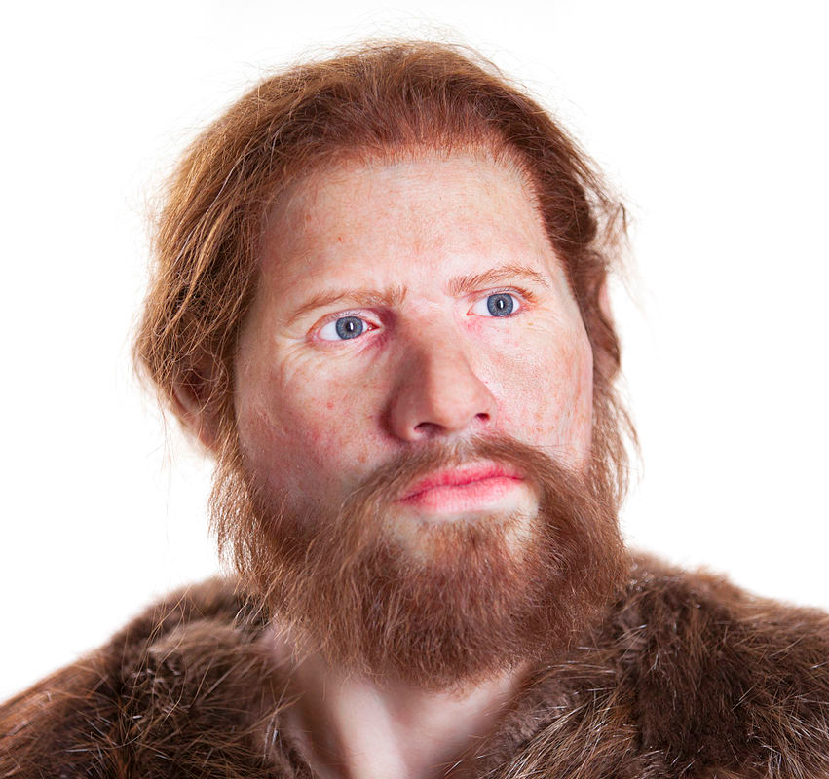
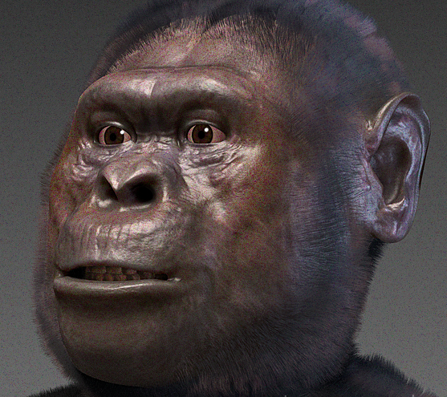
Reasons Christians Should Not Accept Theistic Evolution
11. The Bible teaches that Adam was the first man (Gen. 1:2; 1 Cor. 15:45).
  • Theistic evolution teaches that the first man existed long before Adam (Homo sapiens) and may have been either Homo erectus, Homo habilis, or Australopithecus afarensis (Lucy).
Homo Sapiens
Australopithecus
afarensis

Slide 14
Reasons Christians Should Not Accept Theistic Evolution
12. Genesis 2:18-23 declares that woman was fashioned from a rib taken from the side of man.
  • Theistic evolution maintains that women evolved alongside man over millions of years.

Slide 15
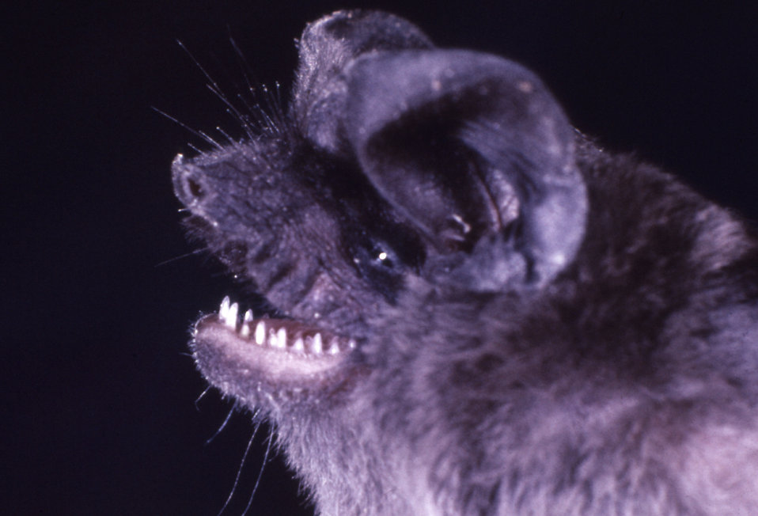
Reasons Christians Should Not Accept Theistic Evolution
13. All animals were, at first, created to be vegetarians (Gen. 1:29-30).
  • Theistic evolution pronounces that the first animals, from the dinosaurs to the great cats, were carnivorous creatures, ravaging and devouring one another.
  • Even today, there are many strict vegetarian animals with sharp, carnivore-like teeth (e.g., fruit bats and giant panda bears).
Jamaican fruit bat

