Slide 1
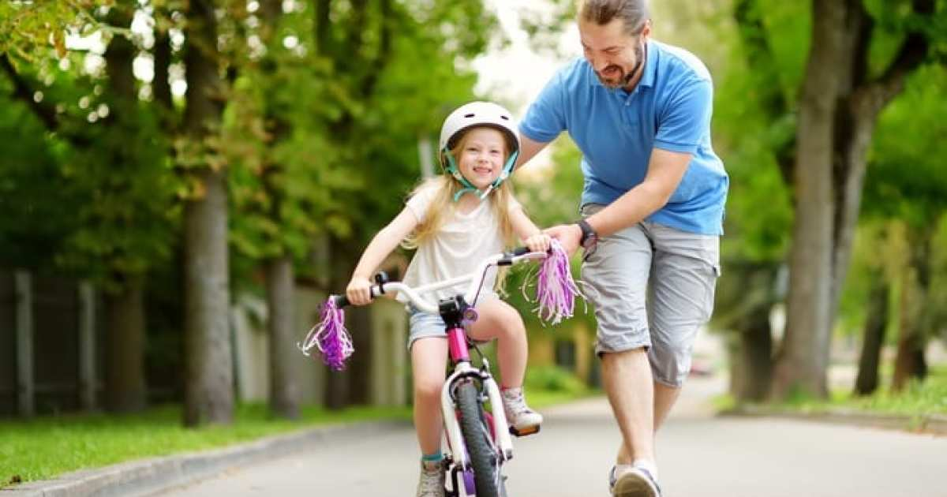

Major Life Milestone
Must Learn Control
Lack of Control Is Frightening

Slide 2
CONTROL
Challenging Aspect of Life
We Feel Anxiety When It Is Absent
We Like to Think We Possess It

Slide 3
CONTROL
Some Problems Come from Lack of Control.
Proverbs 16:32
Anger
Lust
Addiction
Unrest
Debt
Emotions

Slide 4
CONTROL
Some Problems Come from Thinking We Can Control Everything.
Psalm 103:19-22
Worry
Selfishness
Domineering
Weak Faith
Rebellion
Disobedience

Slide 5
CONTROL
From Birth, We Live in Dependence upon the Provision of Others.
God (life, environment, biological functions, conditions necessary for life, etc.)
Parents (conception and birth, sustenance, training)
Teachers, employers, authorities
Psalm 139:13-16

Slide 6
CONTROL
As We Grow, the Sphere of Things We Control Grows Larger.
Ultimately, the Sphere of Things We Control Begins to Shrink.
In the End of Life (or of the World) All Will Yield to the Absolute Control of God.
Ecclesiastes 12:6-7

Slide 7
CONTROL
It Is Vital That We Live Our Lives...
Striving to Control Properly the Areas of Life God Has Entrusted to Our Control (1 Cor. 9:24-28).
While Willingly Yielding Our Lives to the Control of God (Jas. 4:7-10).
2 Peter 1:5-11

Slide 8
CONTROL
God Should “Be in Control” in Our Lives.
What Does That Mean?
It doesn’t mean that God causes our actions or those of others.
It doesn’t mean that everything that happens is because God directly caused it (Jas. 1:13-16).

Slide 9
CONTROL
God Should “Be in Control” in Our Lives.
What Does That Mean?
It means we follow God’s guidance rather not our imagination (1 Thess. 2:13).
It means we can trust His providence to supply our needs in areas we cannot control (Matt. 6:26-30).

Slide 10
CONTROL
God Should “Be in Control” in Our Lives.
What Does That Mean?
It doesn’t mean that He will keep us from experiencing any challenges.
It does mean that He will be with us through all difficulties we face.

Slide 11
CONTROL
God Should “Be in Control” in Our Lives.
What Does That Mean?
It means we can trust God’s promises in areas we cannot control (Ps. 37:25).

Slide 12
CONTROL
We Can’t Control Other People’s Actions.
We can control our influence towards them.
We can control our reactions to their actions (1 Pet. 2:21-24).

Slide 13
CONTROL
We Can’t Control Other People’s Reactions to Our Actions.
We can control our own defensiveness or remorse to them.
We can control potential stumbling blocks we lay before them (Rom. 14:10-13).

