Slide 1
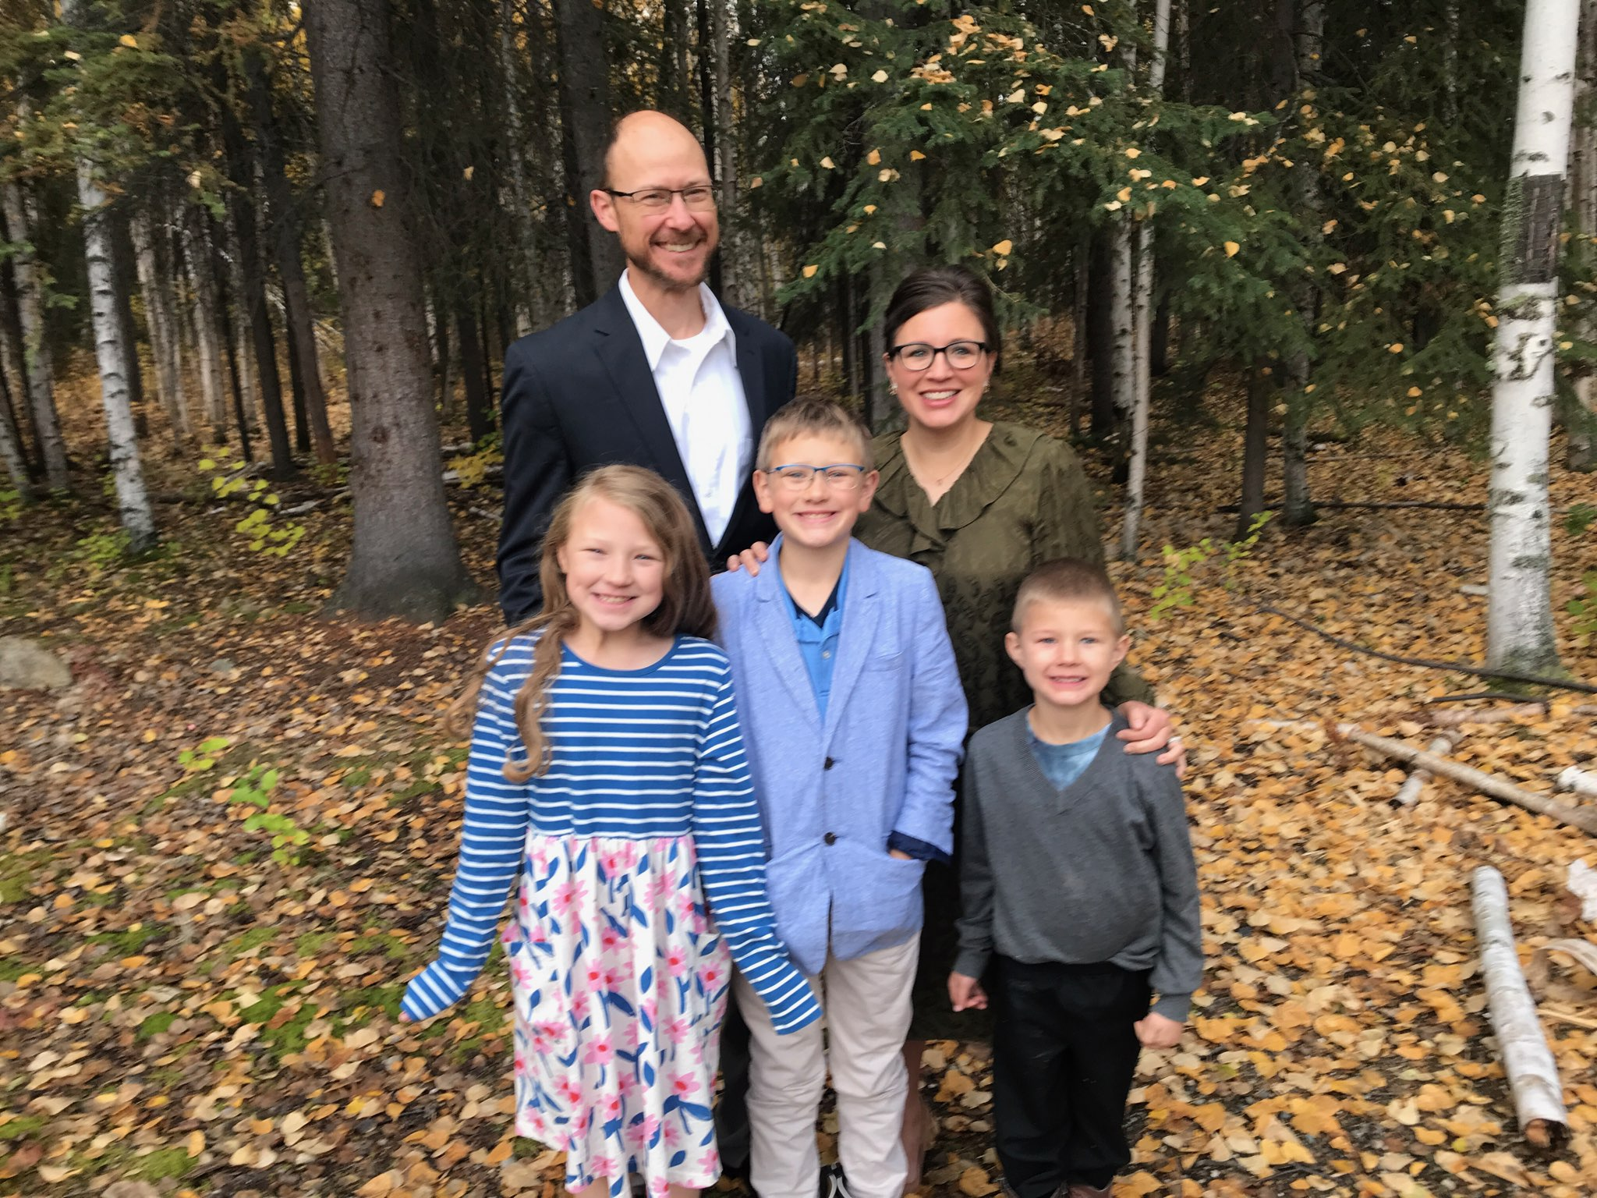
Halbrook Family
David, Starla, Esther, Joel, & Eliel

Slide 2
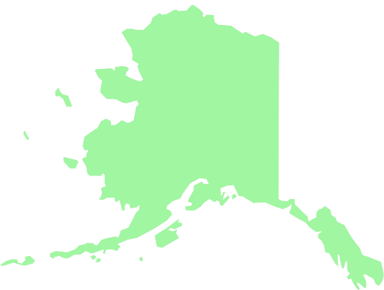
Fairbanks
Chena Small Tracts Church of Christ

Slide 3
Palmer
Palmer
Church of Christ

Slide 4
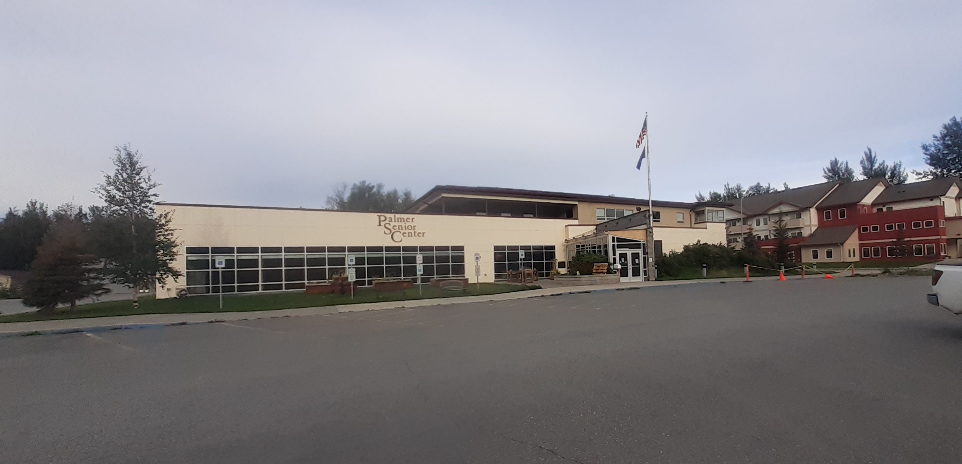
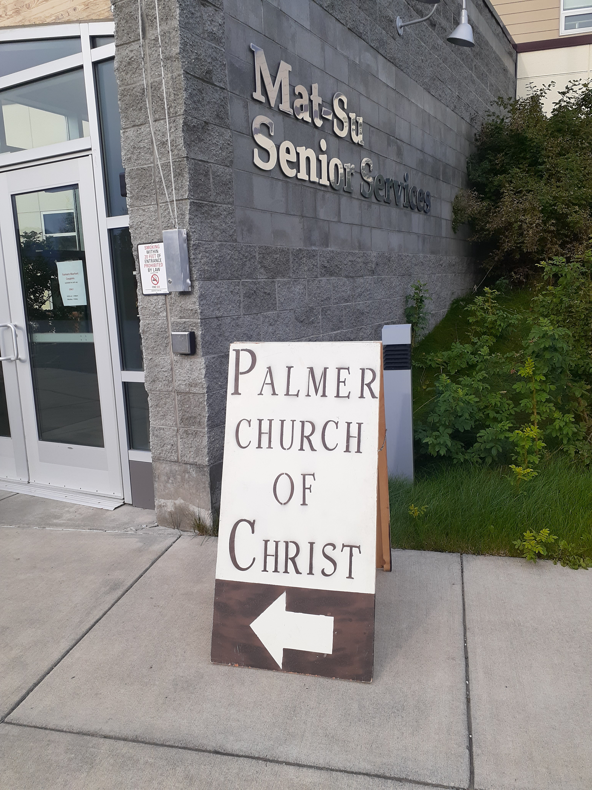
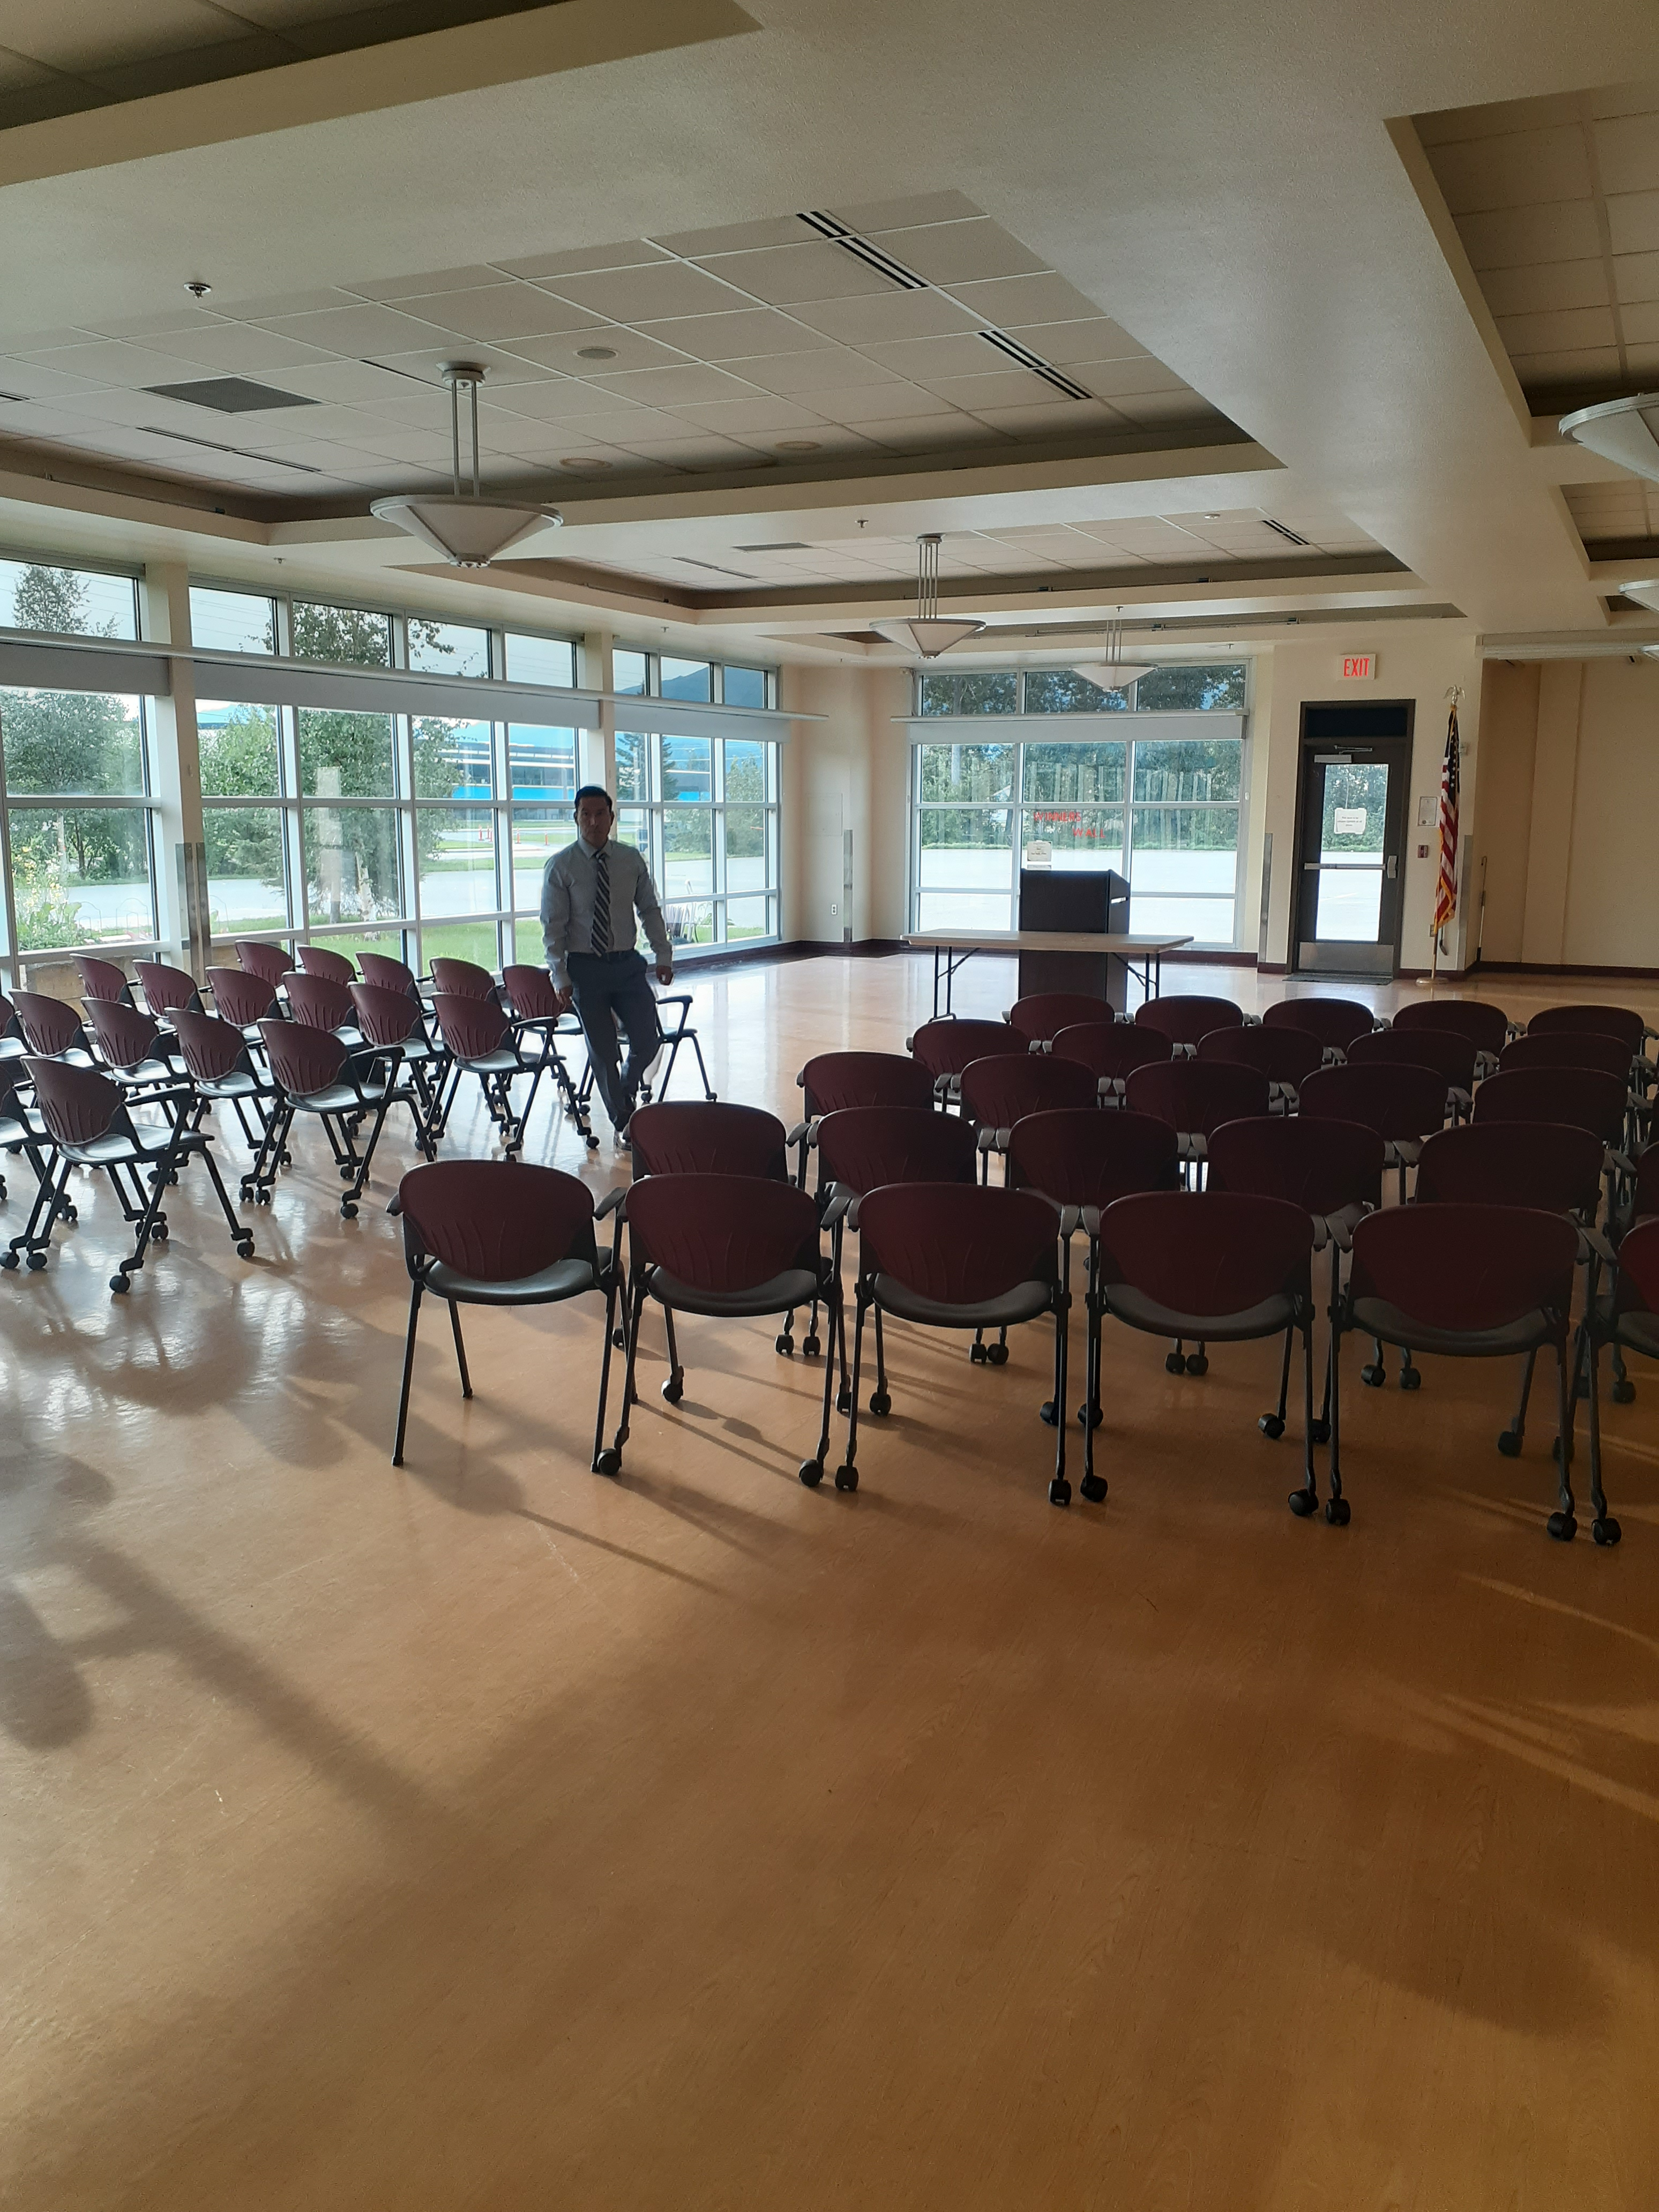
Palmer Church of Christ
Meeting Place

Slide 5
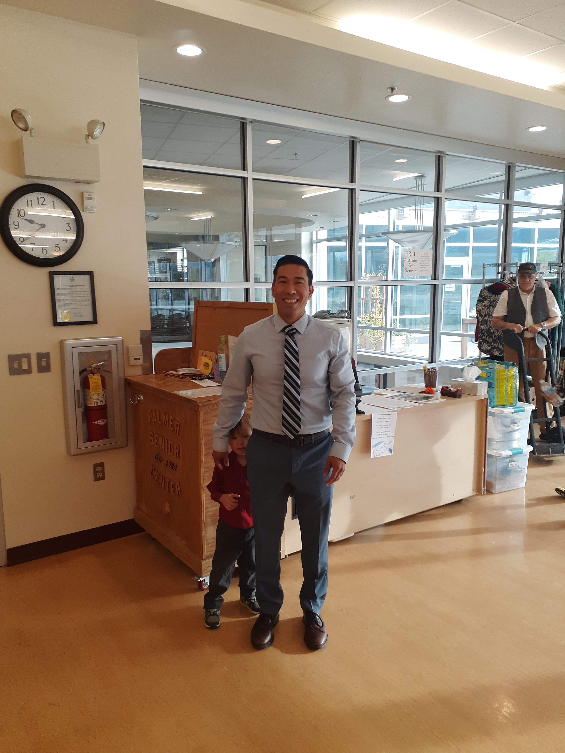
Daniel Schramm
Evangelist

Slide 6
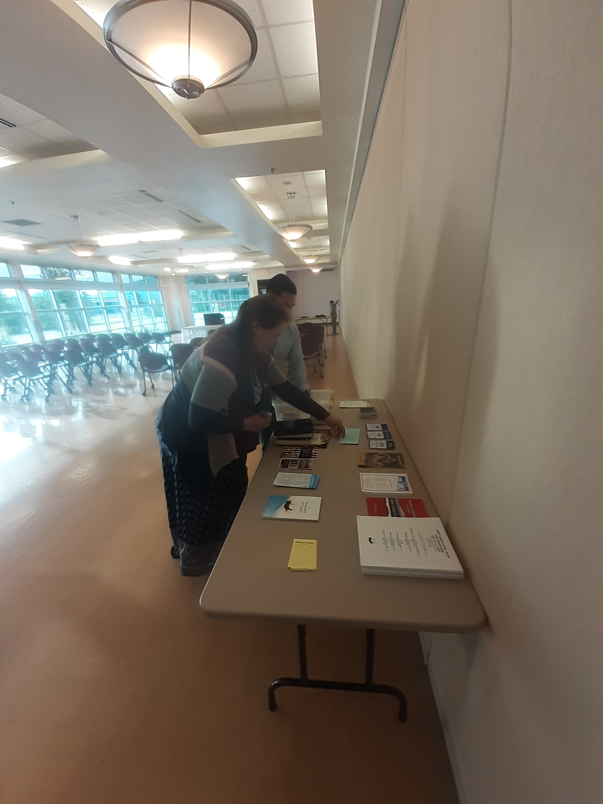

Slide 7
Rick Packo

Slide 8
Sermons Preached at Palmer
Sun. Class.—Faithfulness in Worship
A.M. Worship—Five Reasons You Should Be a Christian
P.M. Worship—Church Discipline
Mon.—What Does the Bible Say about Marriage and Divorce?
Tues.—What about the Thief on the Cross?
Wed.—What Is the Church of Christ?

Slide 9
Anchorage
Rose Street
Church of Christ

Slide 10
Rose Street Church of Christ
Meeting House

Slide 11
David Webb
Evangelist

Slide 12
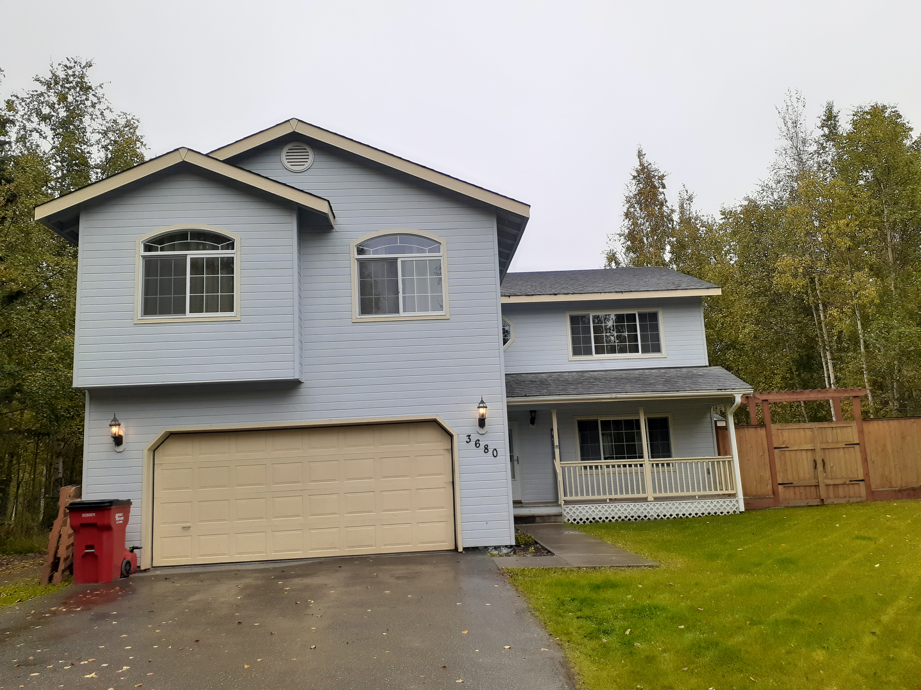
Gann Family
Tyler, Kelsey, Hunter, & Palmer

Slide 13
Sermons Preached at Anchorage
Sat. A.M. Worship—Why Be Baptized?
P.M. Worship—Biblical Patterns
Sun. Class.—"Male and Female"
A.M. Worship—Conversion
P.M. Worship—God's Simple Plan for the Home

Slide 14
Fairbanks
Five hours north
Wasilla

Slide 15
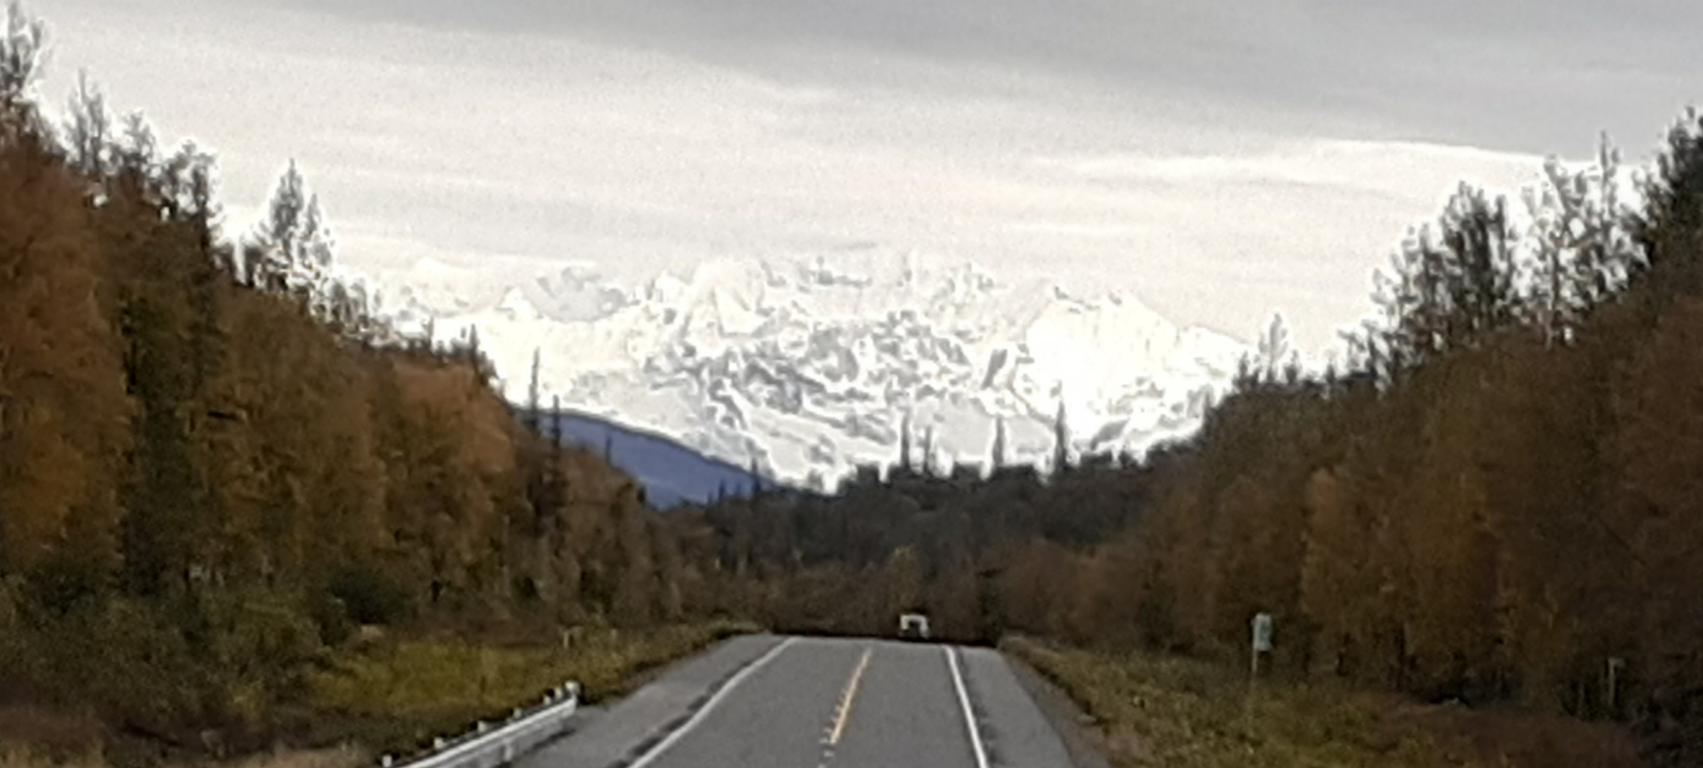
Met half-way at Denali Park

Slide 16
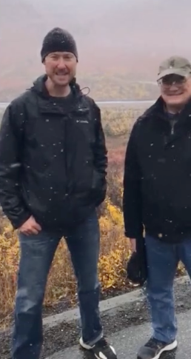
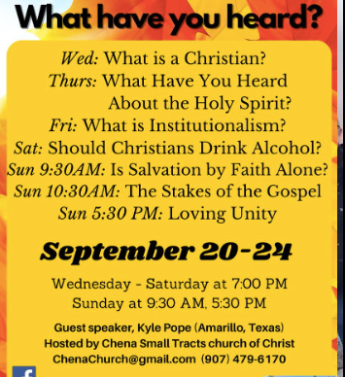

Slide 17
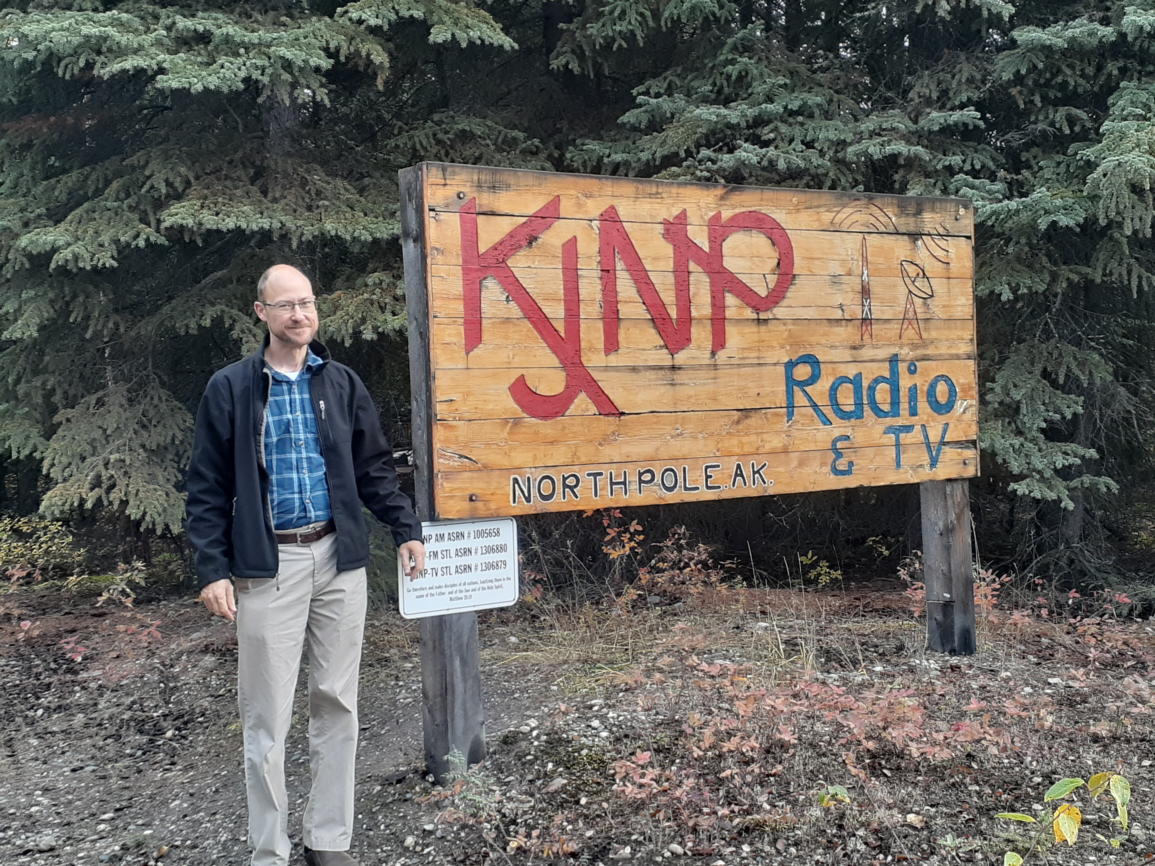
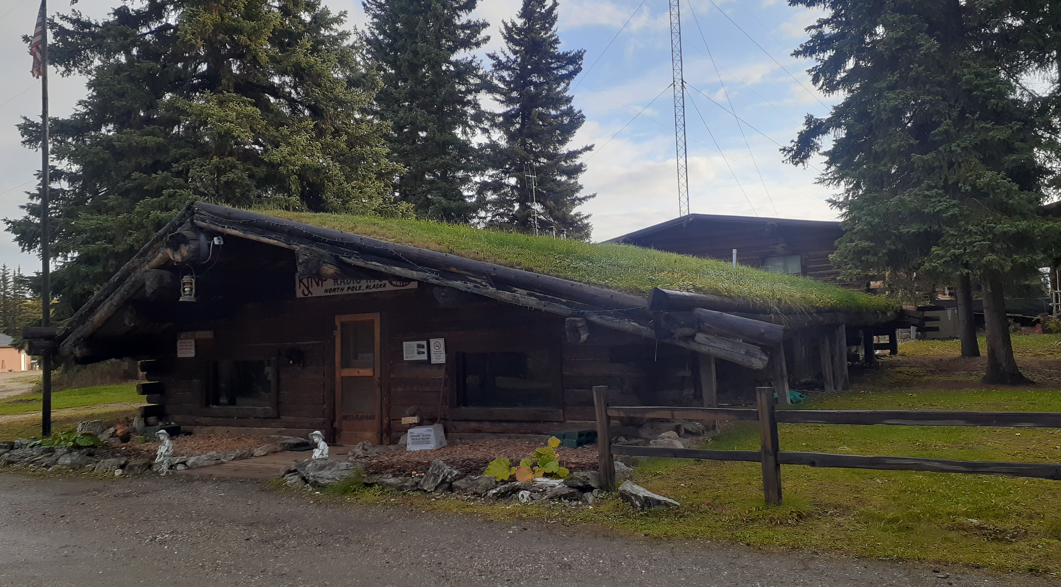
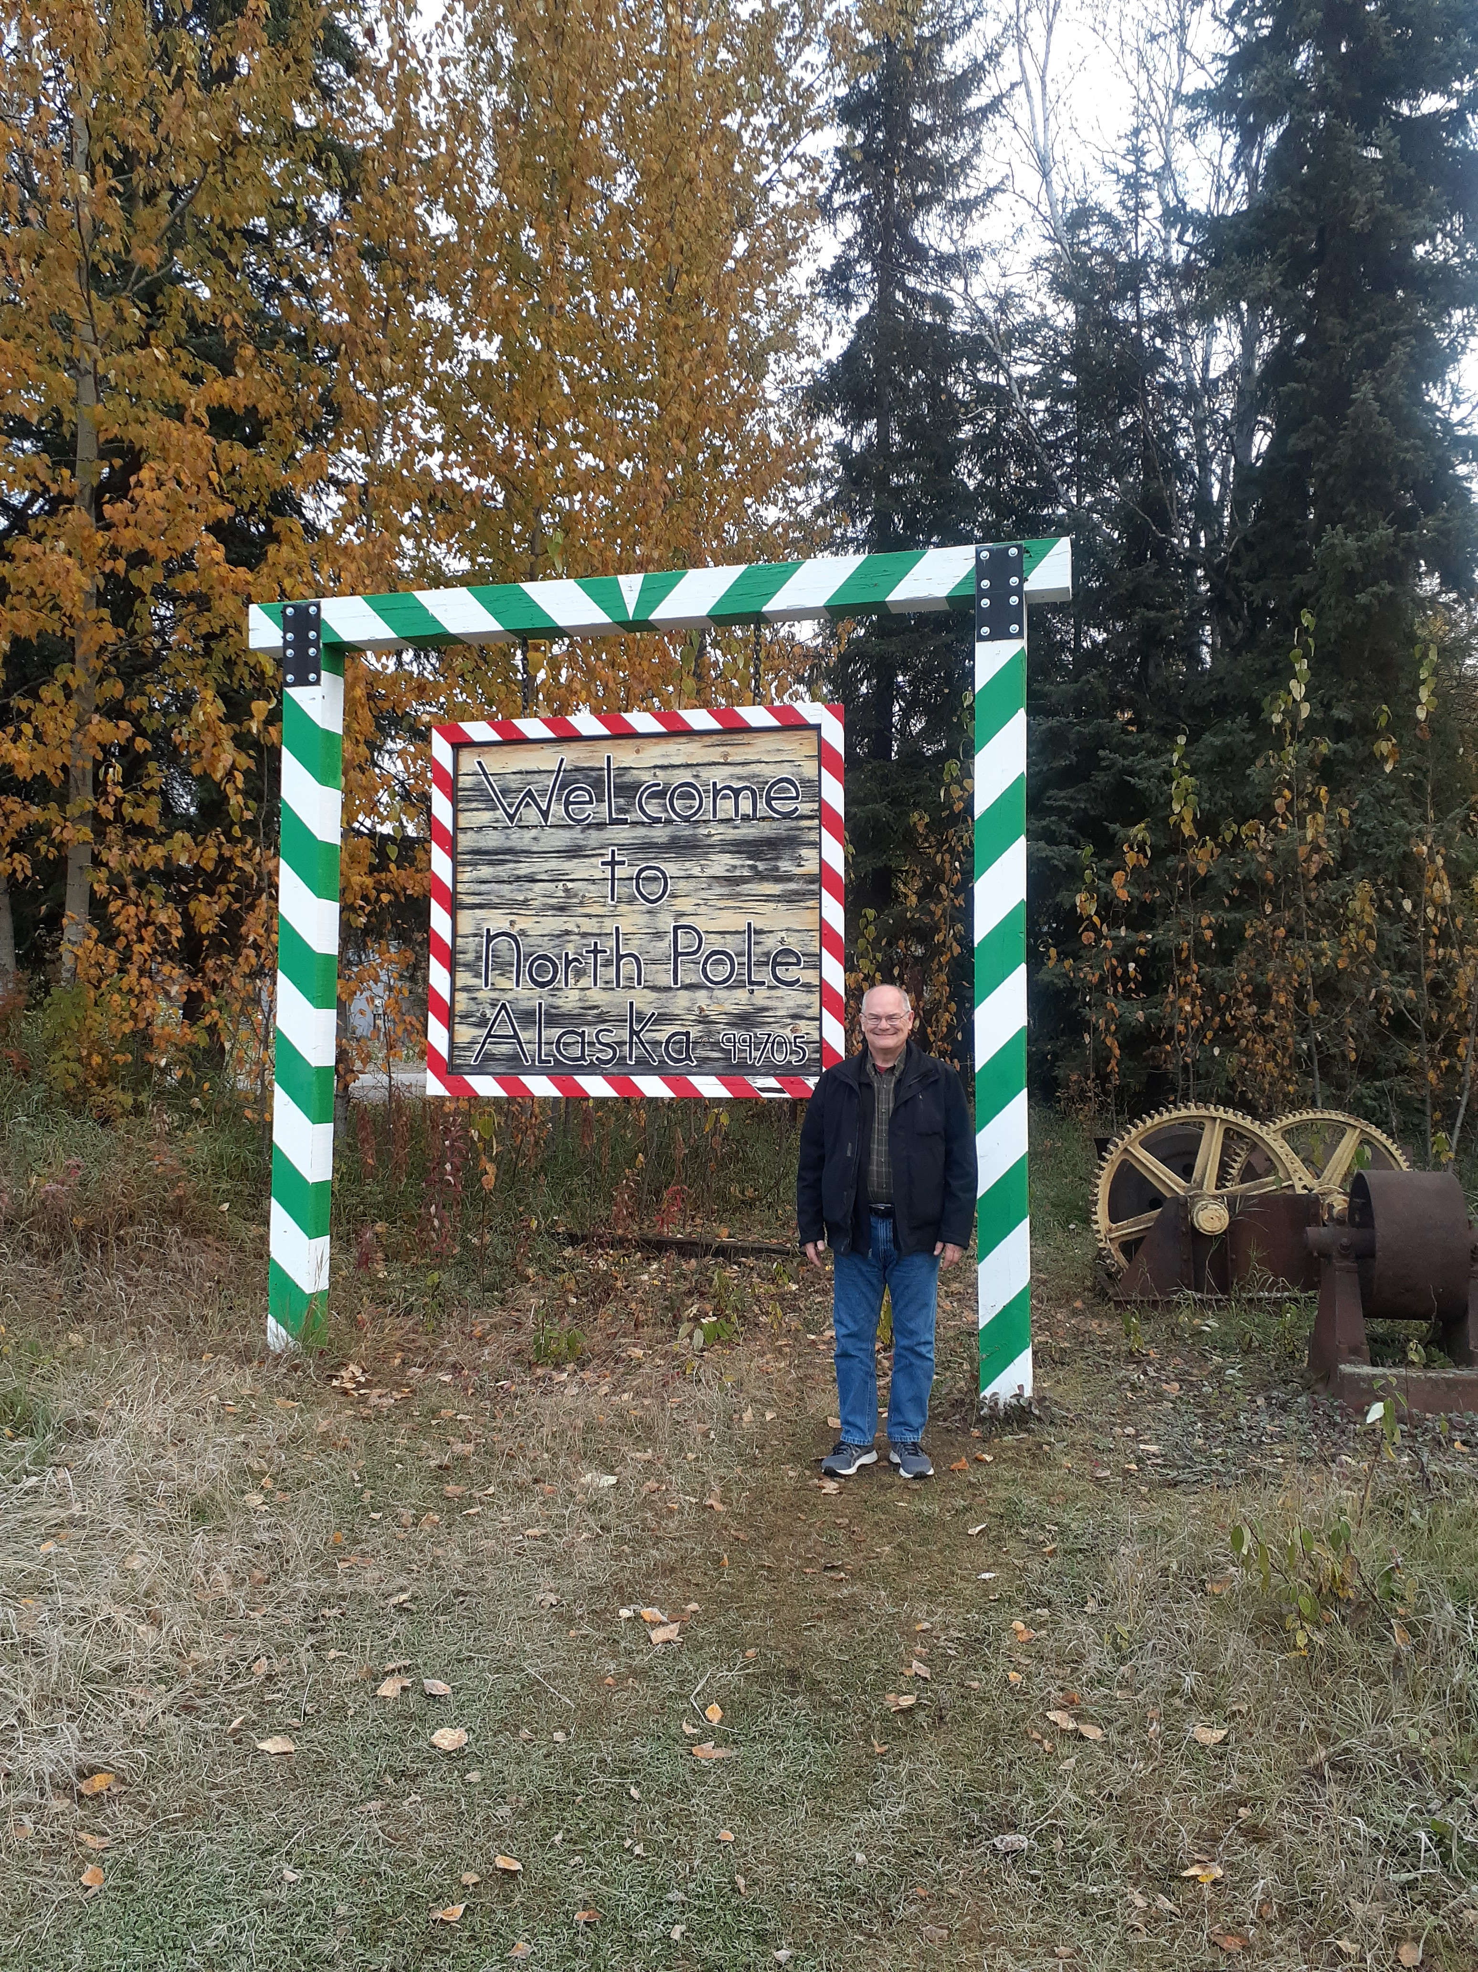
“Words of Truth and Reason”
Tuesday & Thursday 3:30 p.m.

Slide 18
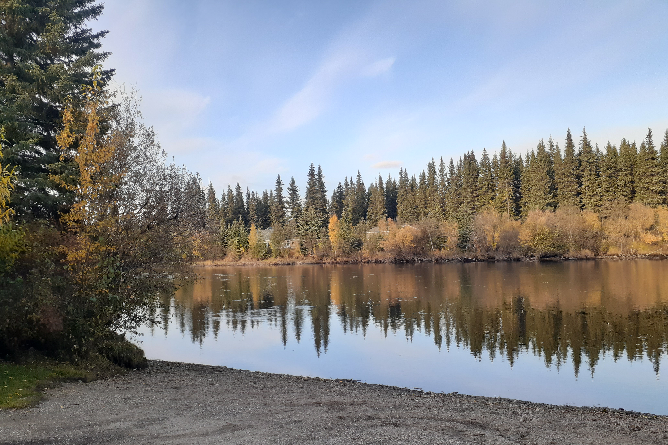
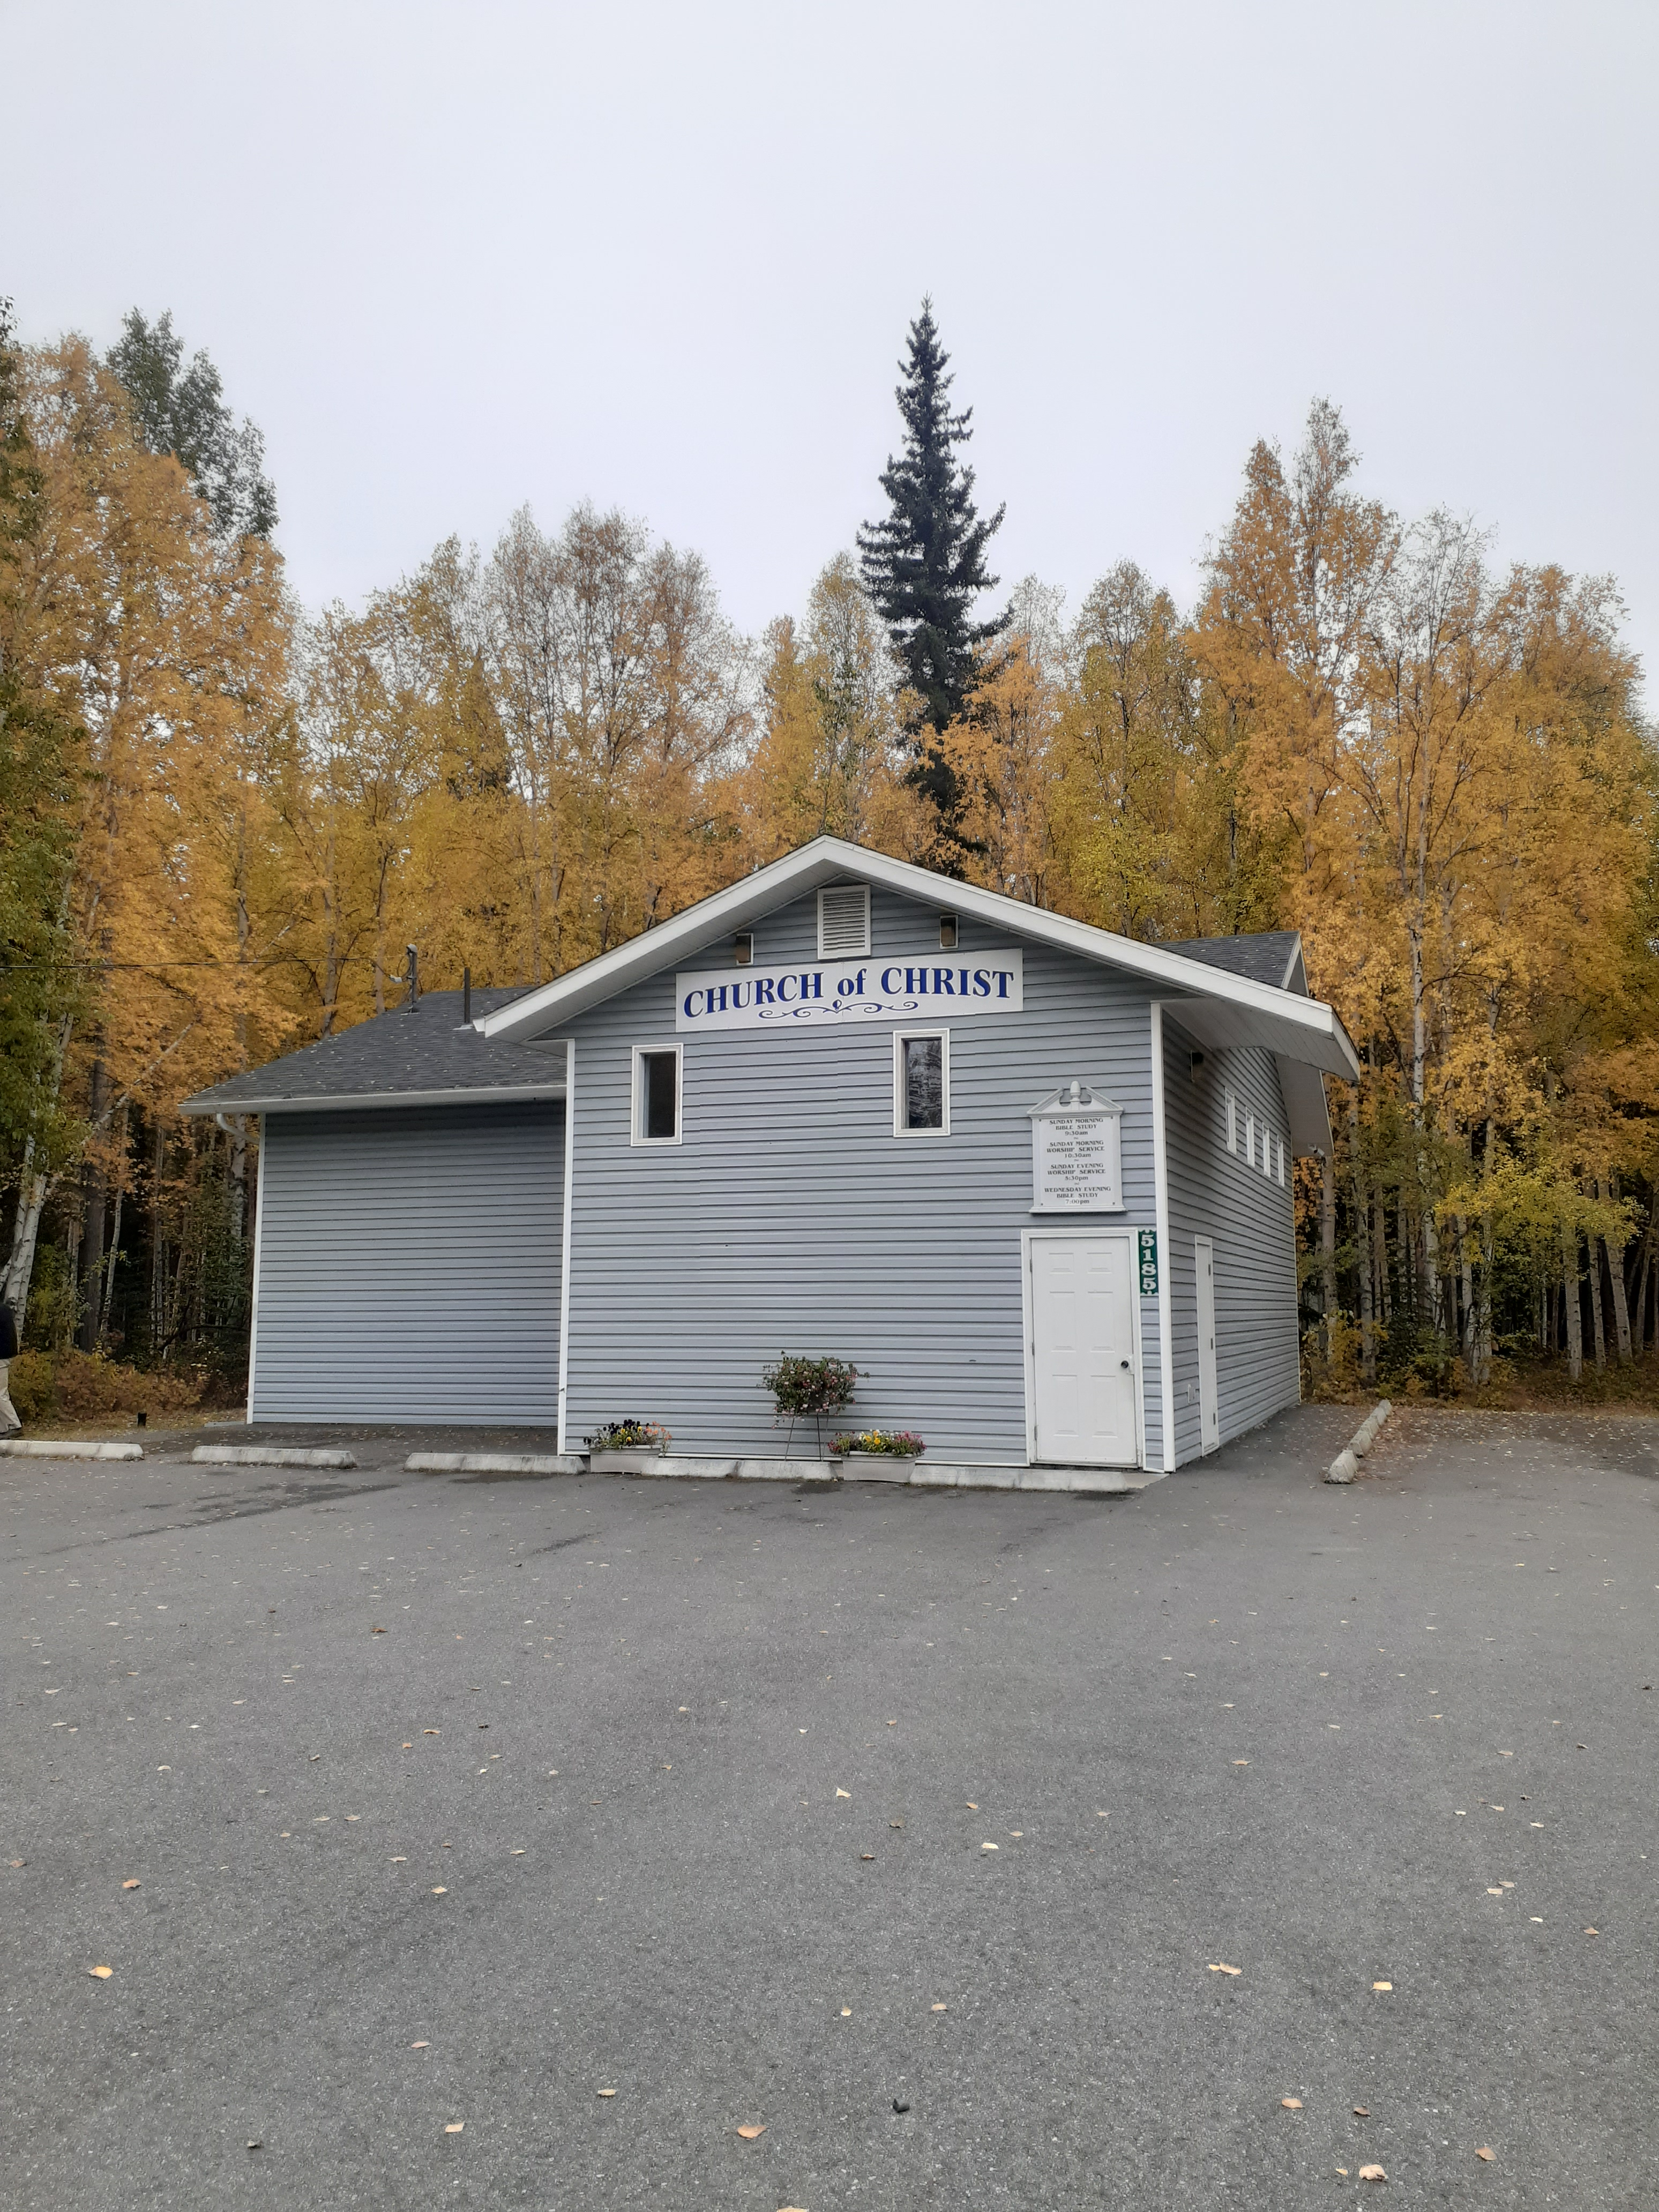
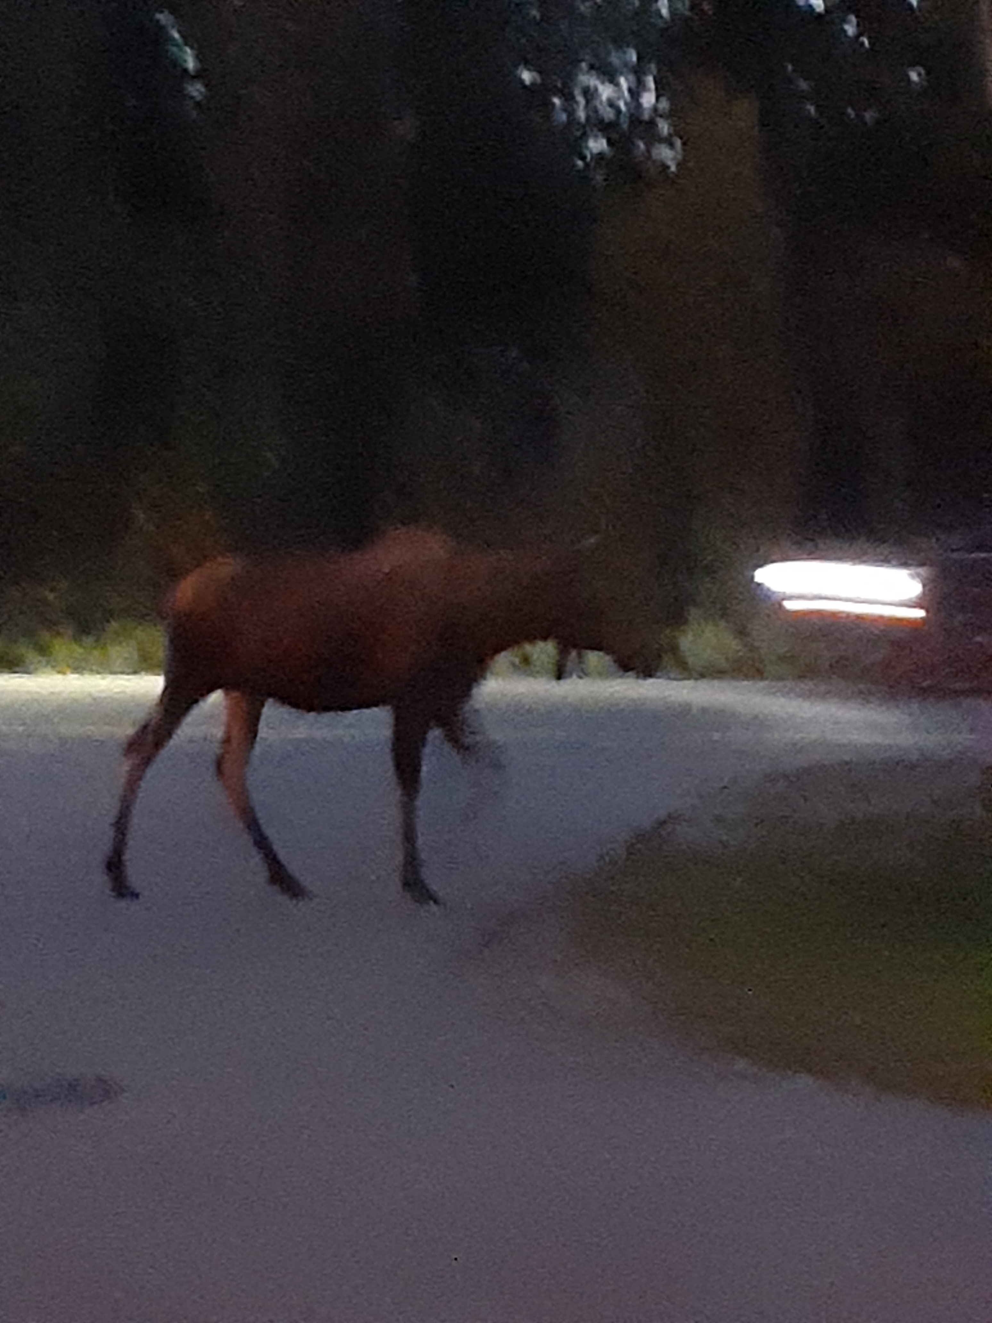
Chena Small Tracts Church of Christ
Meeting Place

Slide 19
Sermons Preached at Fairbanks
Wed.—What Is a Christian?
Thurs.—What Have You Heard about the Holy Spirit?
Fri.—What Is Institutionalism?
Sat.—Should Christians Drink Alcohol?
Sun. Class.—Is Salvation by Faith Alone?
A.M. Worship—The Stakes of the Gospel
P.M. Worship—Loving Unity

Slide 20
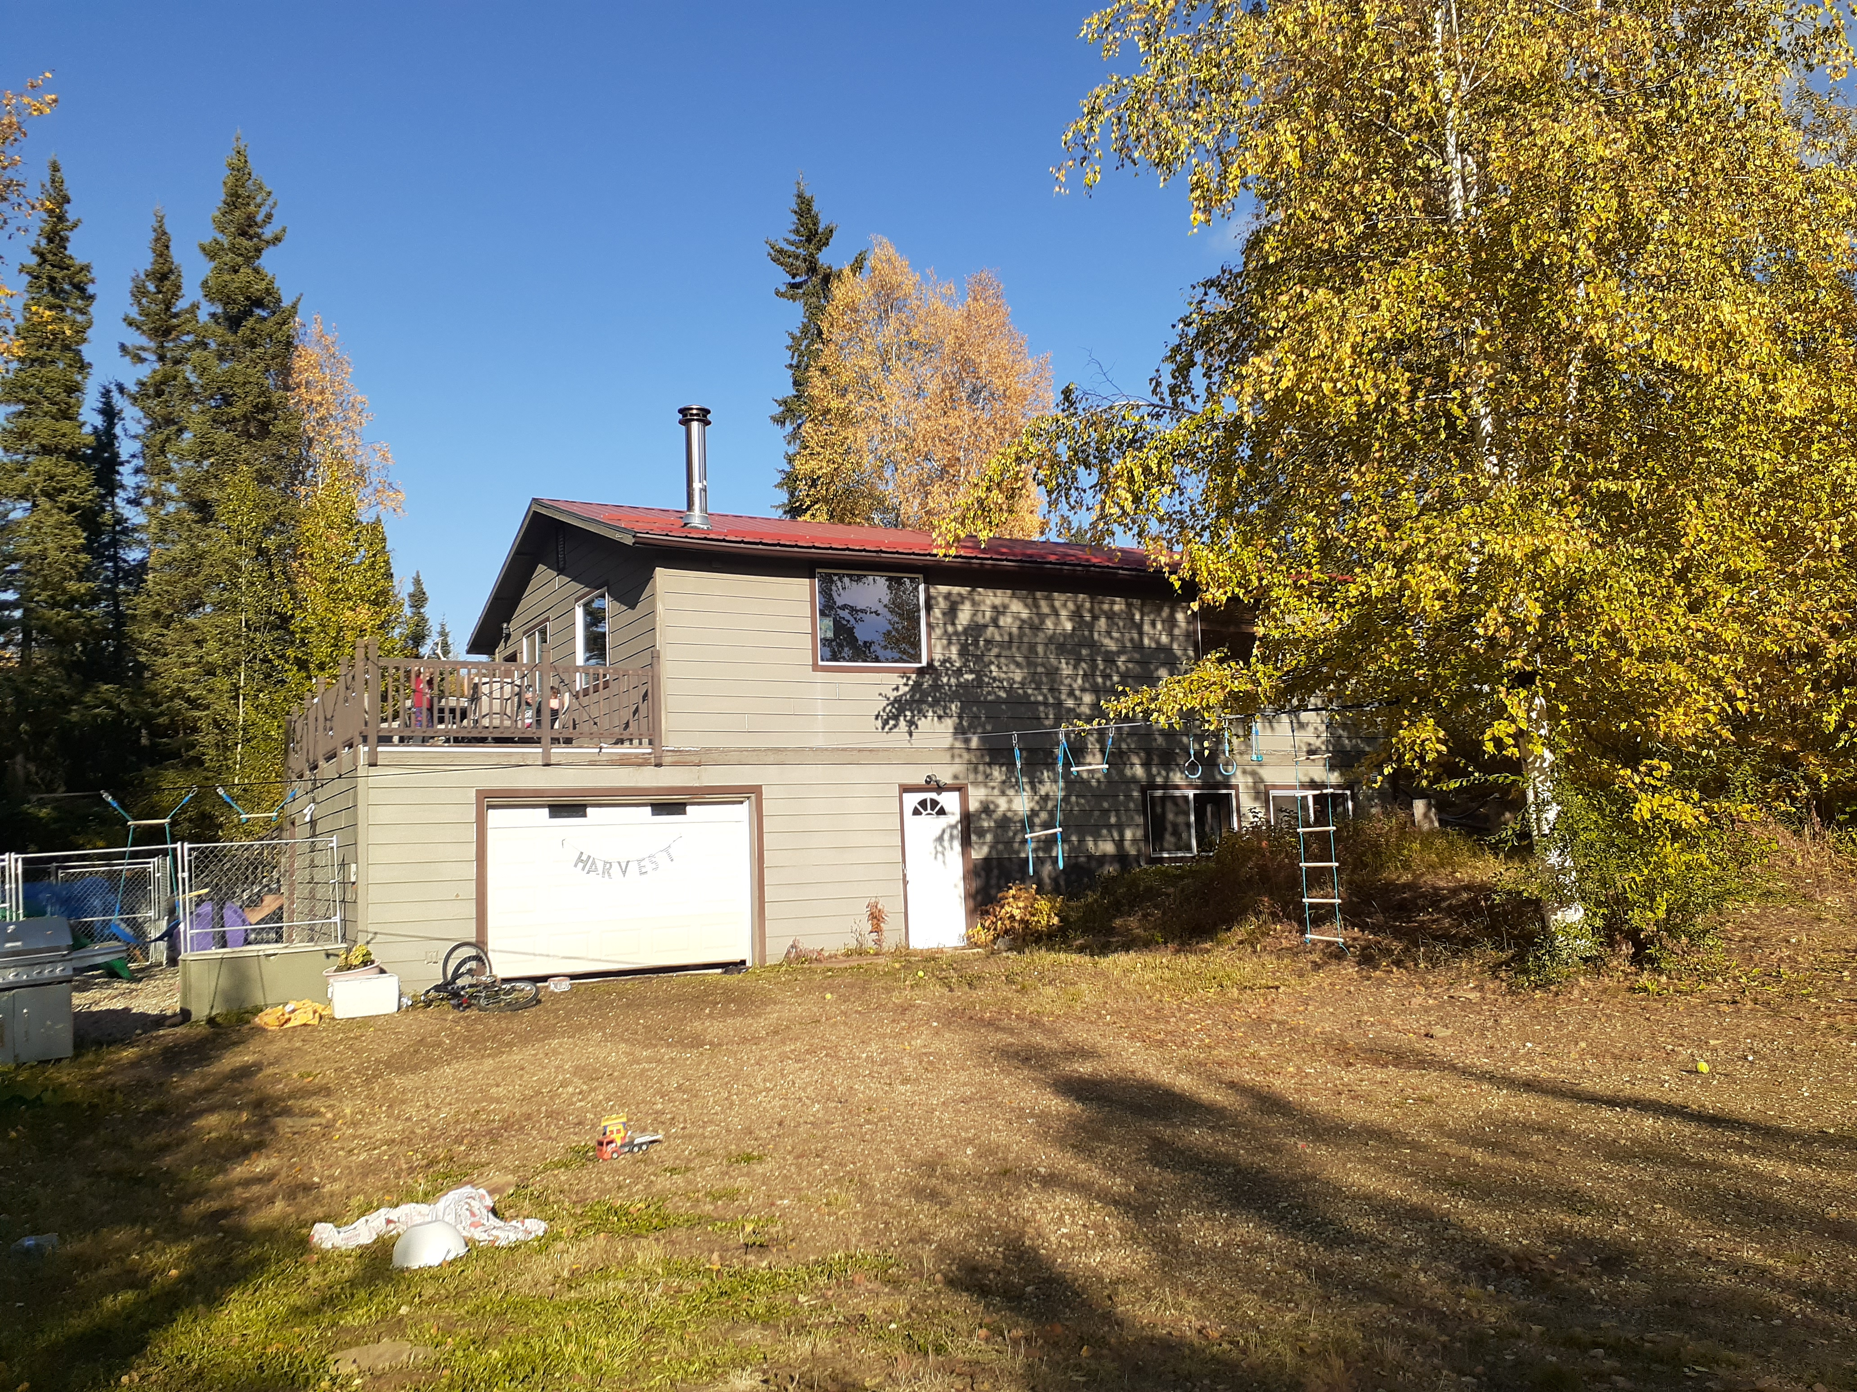
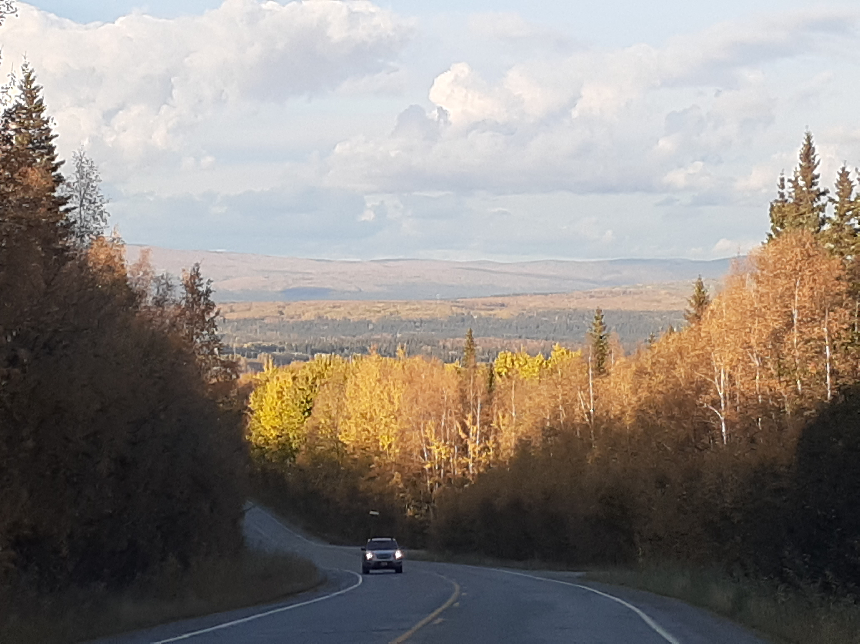
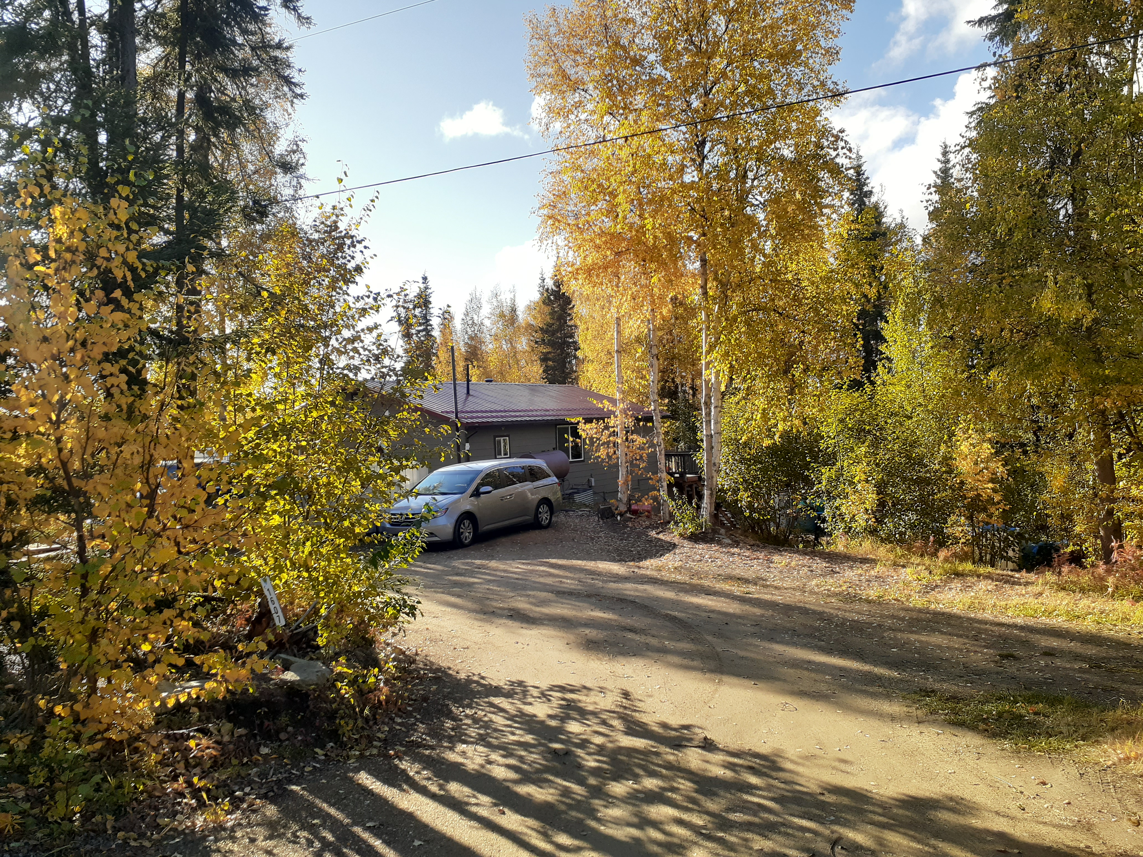

Slide 21
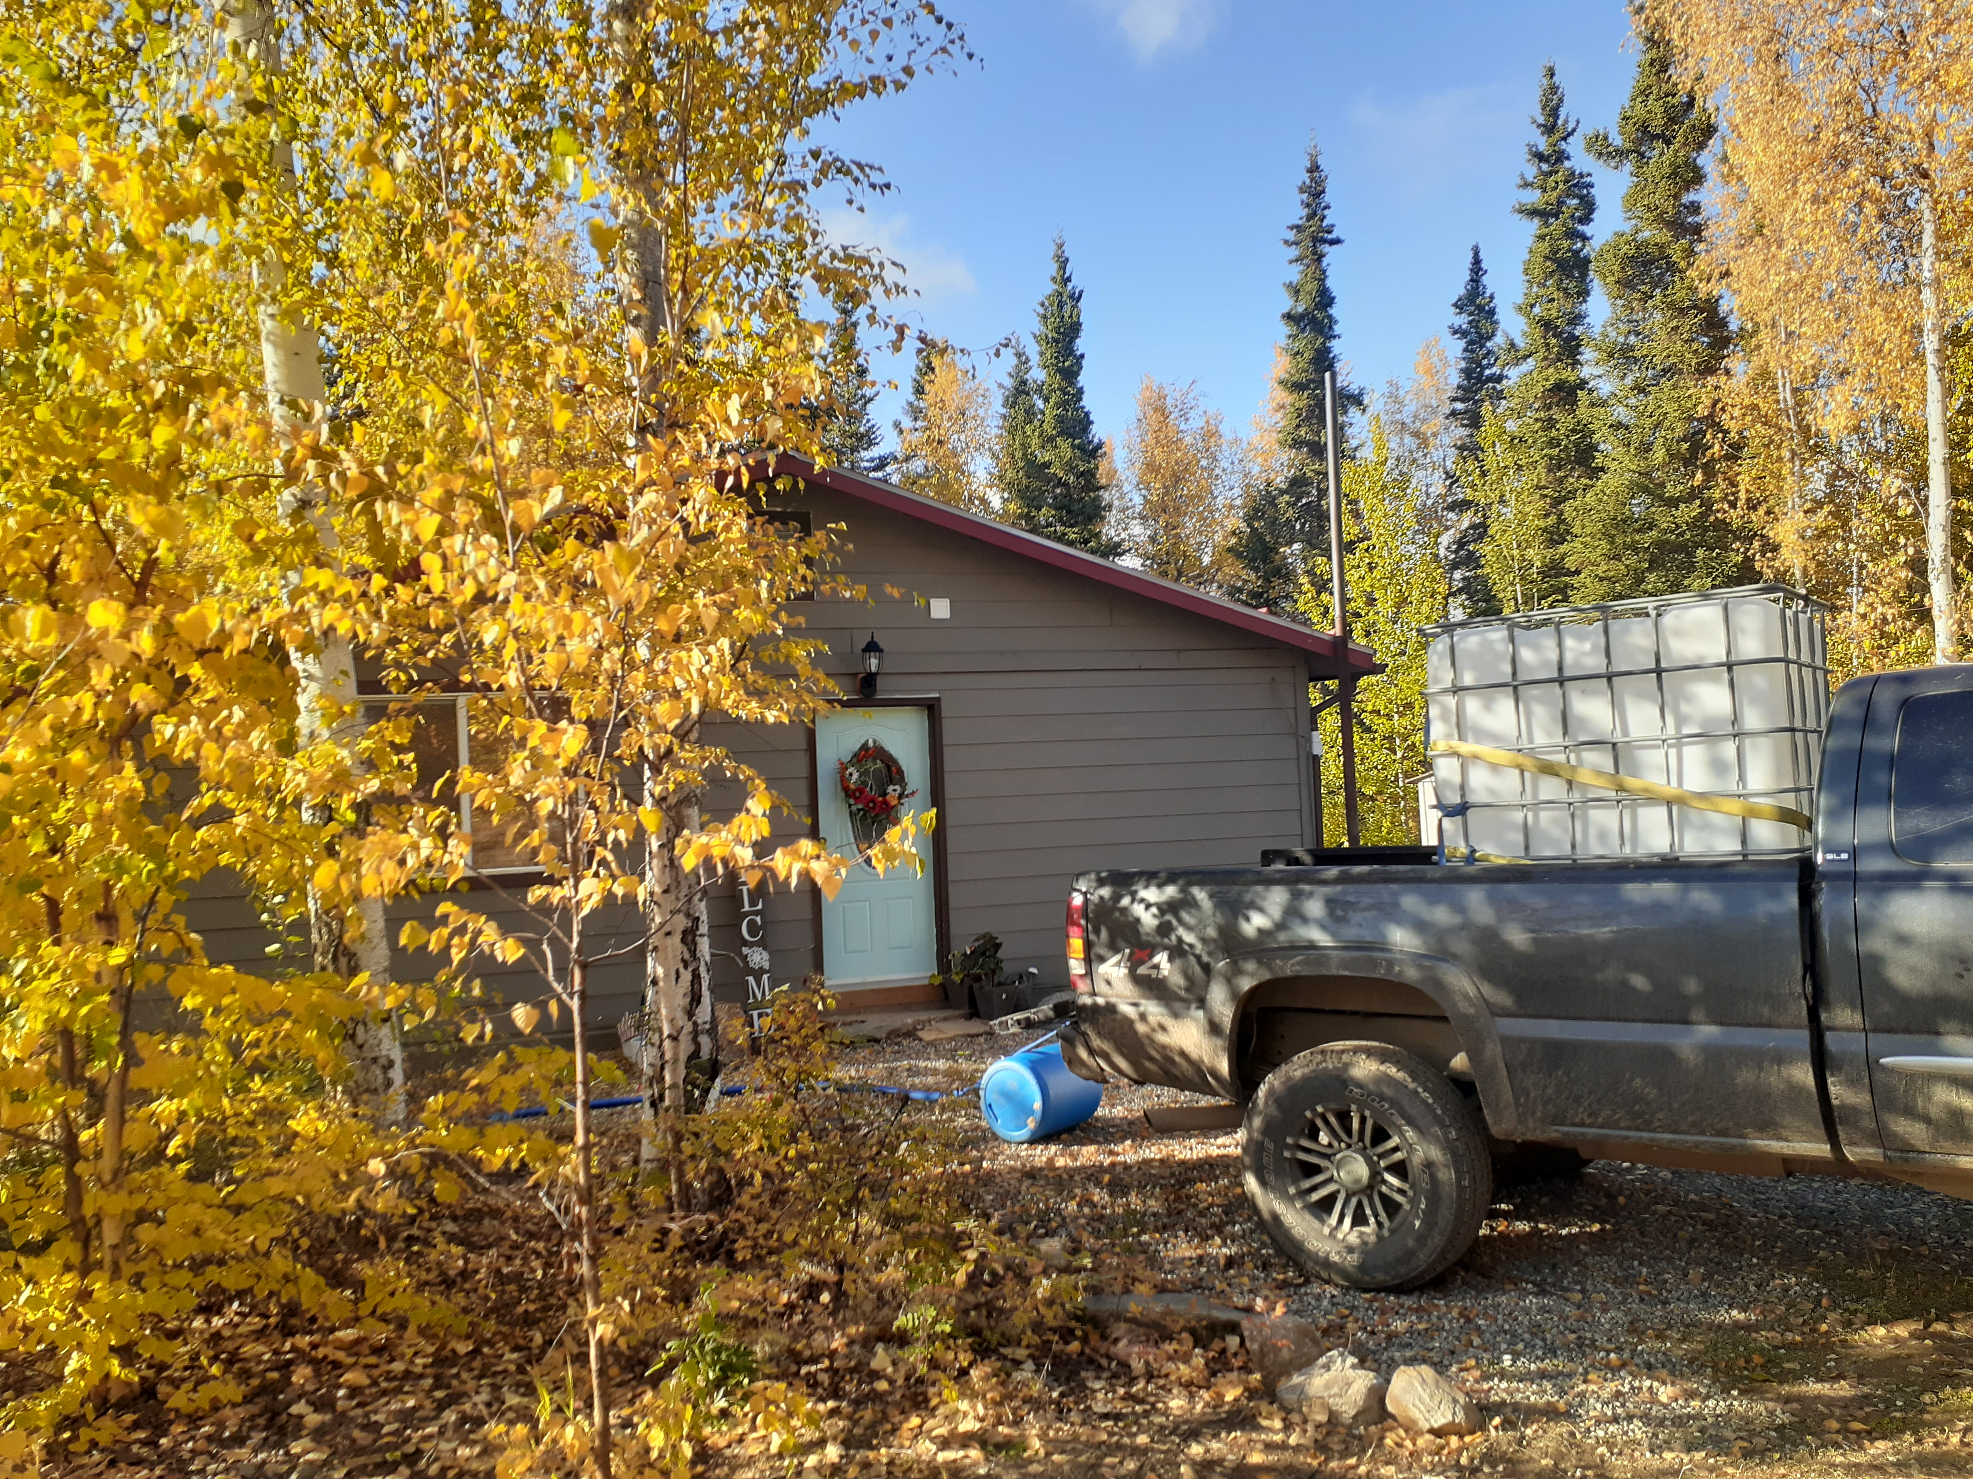
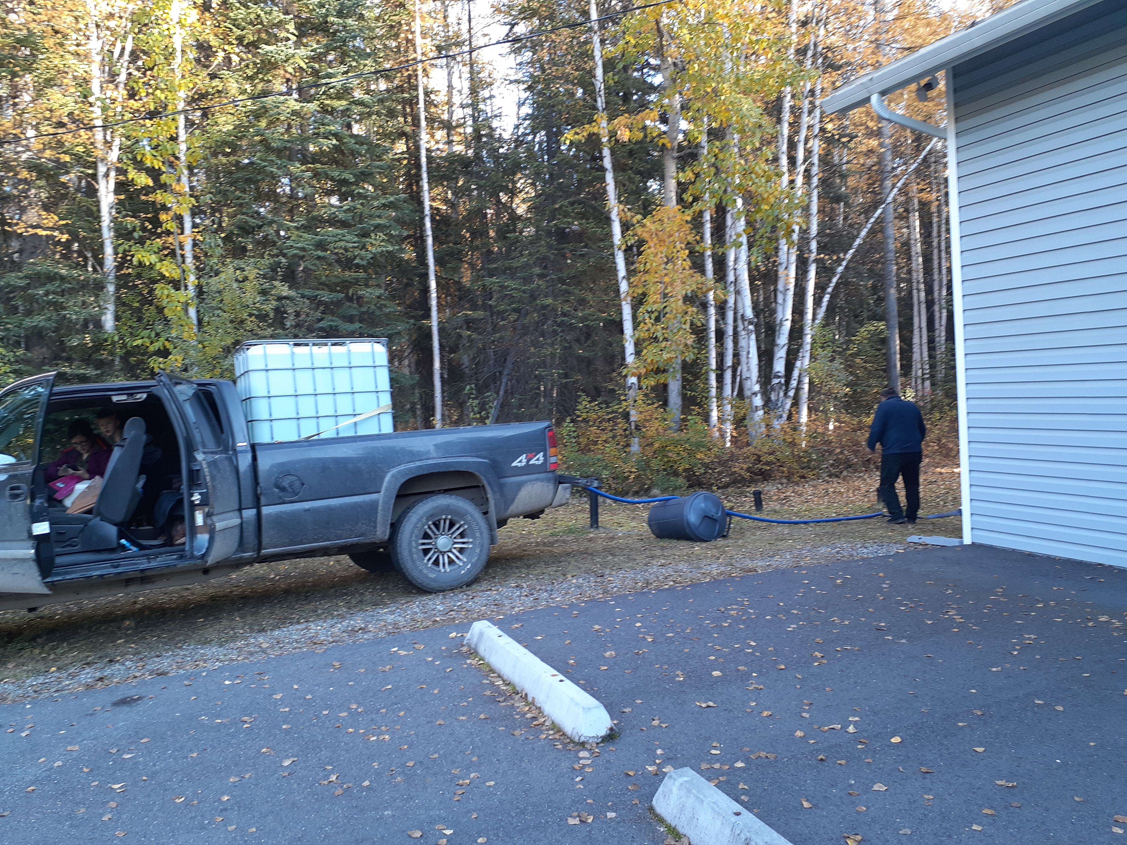
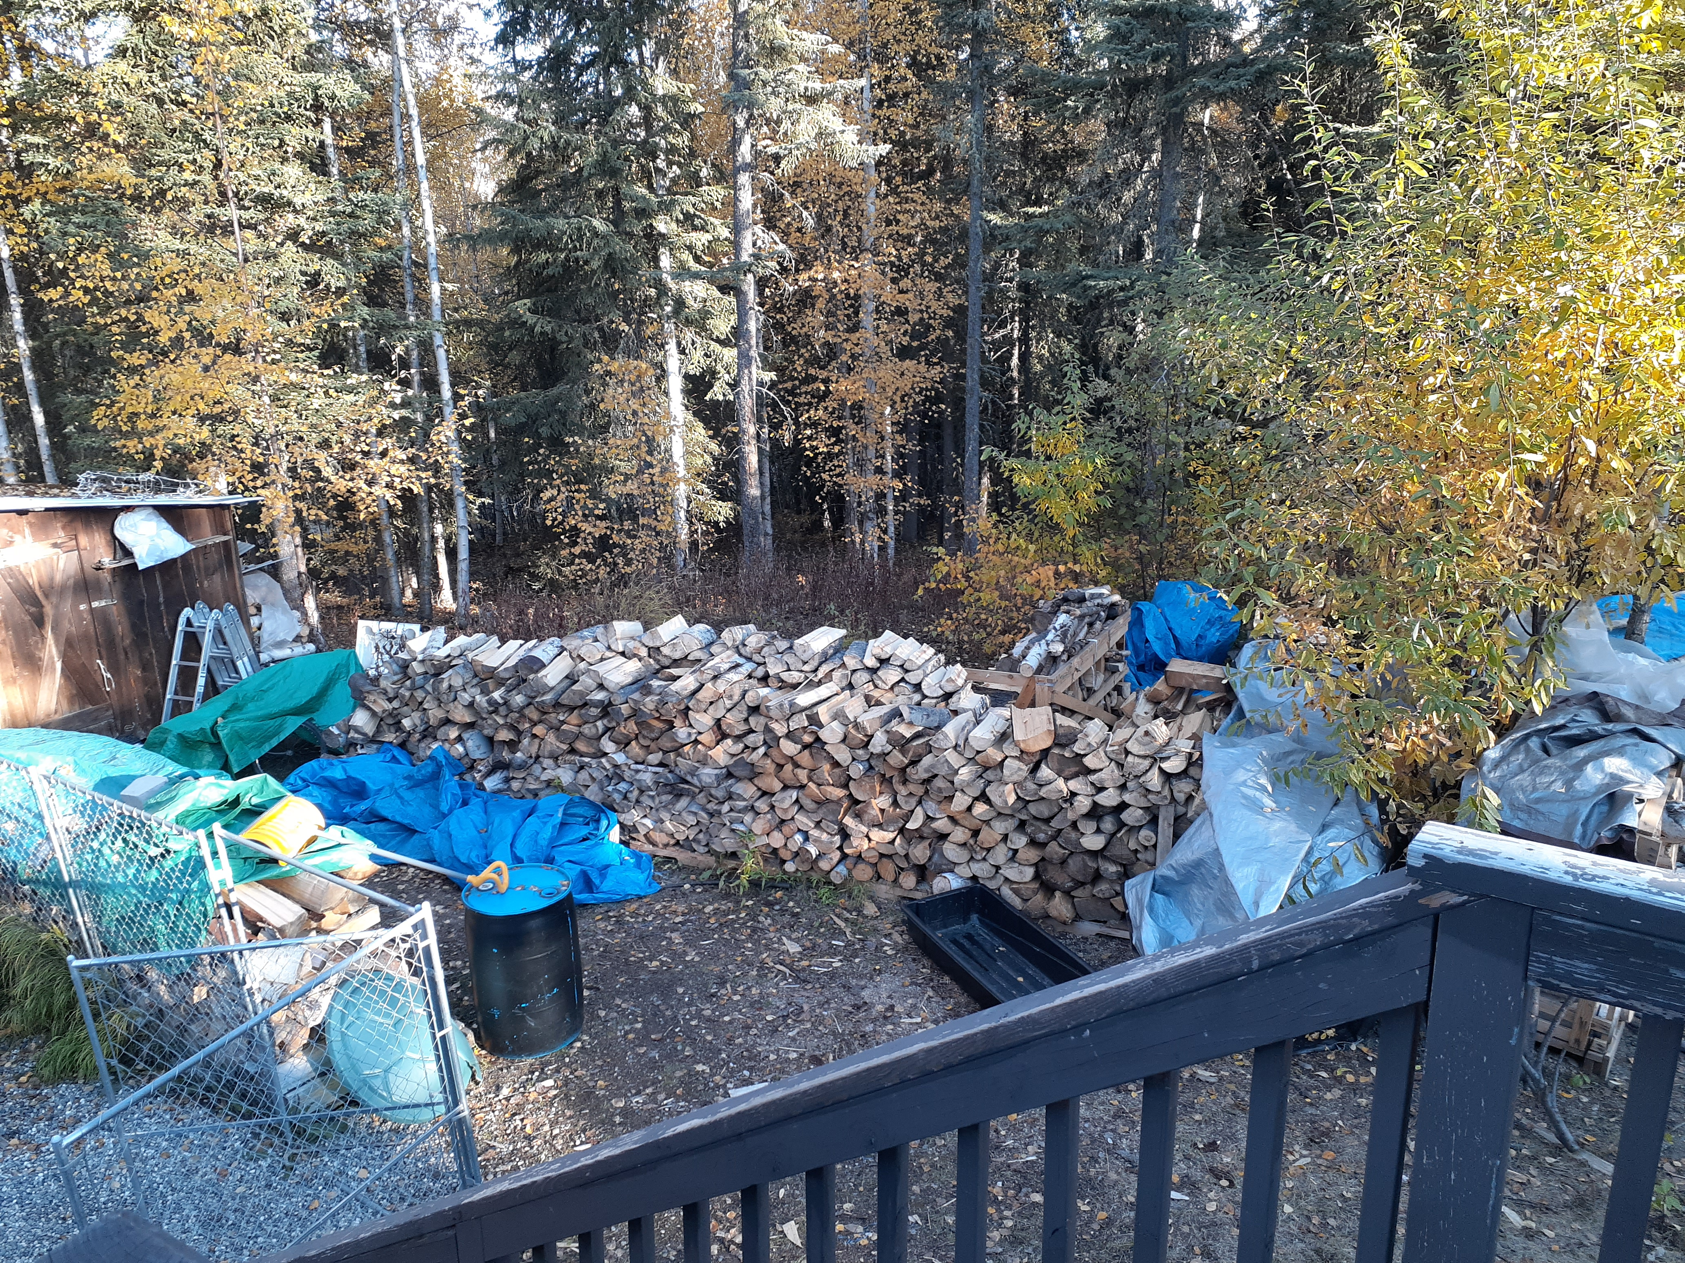

Slide 22
Lessons from Alaska
Authority to Support Preachers (Phil. 4:15-19)
Value of Those Who Teach the Gospel (Isa. 52:7; Rom. 10:11-17)
Importance of Prayer for Such Men and Their Families (Eph. 6:12-20)
Appreciate Our Blessings (Ps. 107:1; 1 Thess. 5:16-18; Phil. 4:6-7)

