Slide 1
John 3:16

Slide 2
Anger

Slide 3
Ephesians 4:26
“Be angry, and do not sin”: do not let the sun go down on your wrath

Slide 4
Mark 3:1-6

Slide 5
1 Timothy 2:8

Slide 6
Colossians
3:1-17

Slide 7
Ephesians
4:17-32

Slide 8
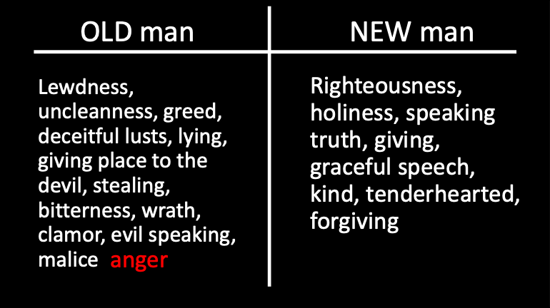

Slide 10
James 1:19-20

Slide 11
So… what?

Slide 12
Think about yourself more

Slide 13
Let God
be God

Slide 14
Never repay evil for evil to anyone. Respect what is right in the sight of all people. If possible, so far as it depends on you, be at peace with all people. Never take your own revenge, beloved, but leave room for the wrath of God, for it is written: “Vengeance is Mine, I will repay,” says the Lord. “But if your enemy is hungry, feed him; if he is thirsty, give him a drink; for in so doing you will heap burning coals on his head.” Do not be overcome by evil but overcome evil with good. – Romans 12:17-19 (NASB)

Slide 15
Rest in the Lord and wait patiently for Him; Do not get upset because of one who is successful in his way, because of the person who carries out wicked schemes. Cease from anger and abandon wrath; do not get upset; it leads only to evildoing. For evildoers will be eliminated, But those who wait for the Lord, they will inherit the land. Yet a little while and the wicked person will be no more; And you will look carefully for his place and he will not be there. – Ps. 37:7-10 (NASB)

